Slide 2
Health, Safety & Environmental Management System 2018

Slide 3
Health, Safety & Environmental Management System (HSE MS) Guide
Welcome to PDO’s HSE MS.
This presentation will explain:
What the HSE-MS is.
Why was it simplified.
What’s in and what’s out of the HSE-MS.
How it is controlled.
Where do you find it.
And provide some examples of the simplified HSE-MS Processes.
So let’s get started!!

Slide 4
What is PDO’s HSE-MS?
PDO obeys the laws of Oman, as well as requirements of its shareholders an stakeholders. It does this by identifying what these requirements are, and then captures these in the form of the business policies and practices of the PDO Control Framework.
These consist of different documents (Policies, Code of practice, Procedures and Specifications, which direct how work is done within PDO. The HSE MS is thus the collection of these requirements that are needed to manage health, safety and environment activities and it;
Ensures compliance with Oman legal requirements
Helps protect employees
Includes ISO 14001:2015 requirements (Environmental management)
Includes ISO 45001:2018 requirements (Occupational Health & Safety)
is a process based system. (Each activity has inputs and outputs)
Includes core operational requirements.
Presents activities on as 1 page processes
Links activities where required.
Eliminates duplication
Is easy to use and access

Slide 5
Why was the HSE-MS simplified?
Audits consistently found non-compliance to HSE MS requirements, evidenced by Procedures and Specifications which had;
Technically incorrect information
Procedures written as Specifications and vise versa
Guideline were used for compliance purposes
Documents were long
Sequence were often wrong
Roles and responsibilities unclear
Requirements were not clear
Contradicting information, etc.

Slide 6
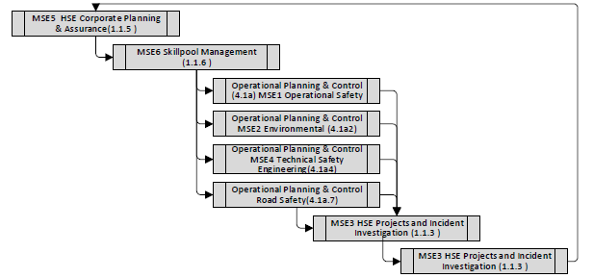
What’s in and what’s out of the HSE-MS?
20-30%
This is the part that matters!!!
In HSE_MS
In the HSE MS
1. Process flow diagrams replace procedures. These define the steps of an activity or task. They define the Why, What Who, Where When and How. Example: The Steps to be followed in getting PTW approval for welding a pipeline
2. Specifications are kept in the Corporate Management System (CMS) and are linked where required. Specifications describe measurable criteria (how many / how much) Example: SP-2000 vehicle requirements
3. Supporting documentation. Example: Checklists, templates, Reference documents, Legal requirements, Forms.
OUT of the HSE MS
Old style Procedures. These are replaced by Process Flow Diagrams
Guidelines: Process flows are clear enough. There is no longer a need for guidelines.
70 - 80 % of the document
was not addressing the activities involved NOT IN HSE-MS

Slide 7
How is the HSE-MS controlled?
PDO personnel access from the Intranet. Intranet users have direct access to all documents.
Contractors access from the internet. If a document is “Restricted” A message stating “document unavailable” will appear on screen) and access is then via Contract Holders.
HSE-MS is centrally coordinated for change management.
Compliance to the HSE-MS is not negotiable!
Version control information on each page?

Slide 8
How is the HSE-MS controlled?
Always available on website (Electronically)
Always current: As changes are approved, they are published.
PDO personnel access from the Intranet.
Contractors access from the internet.
No hard copies printed for distribution!
NB: Working copies are only valid for 1 day
BUT ONLY IF THE PERSON PRINTING THEM SIGNS AND DATES THE COPY MANUALLY
AND RE-SIGNS IT IF THEY USE IT AGAIN ON ANOTHER DAY!!
Undated copies, or copies older than 1 day are uncontrolled.

Slide 9
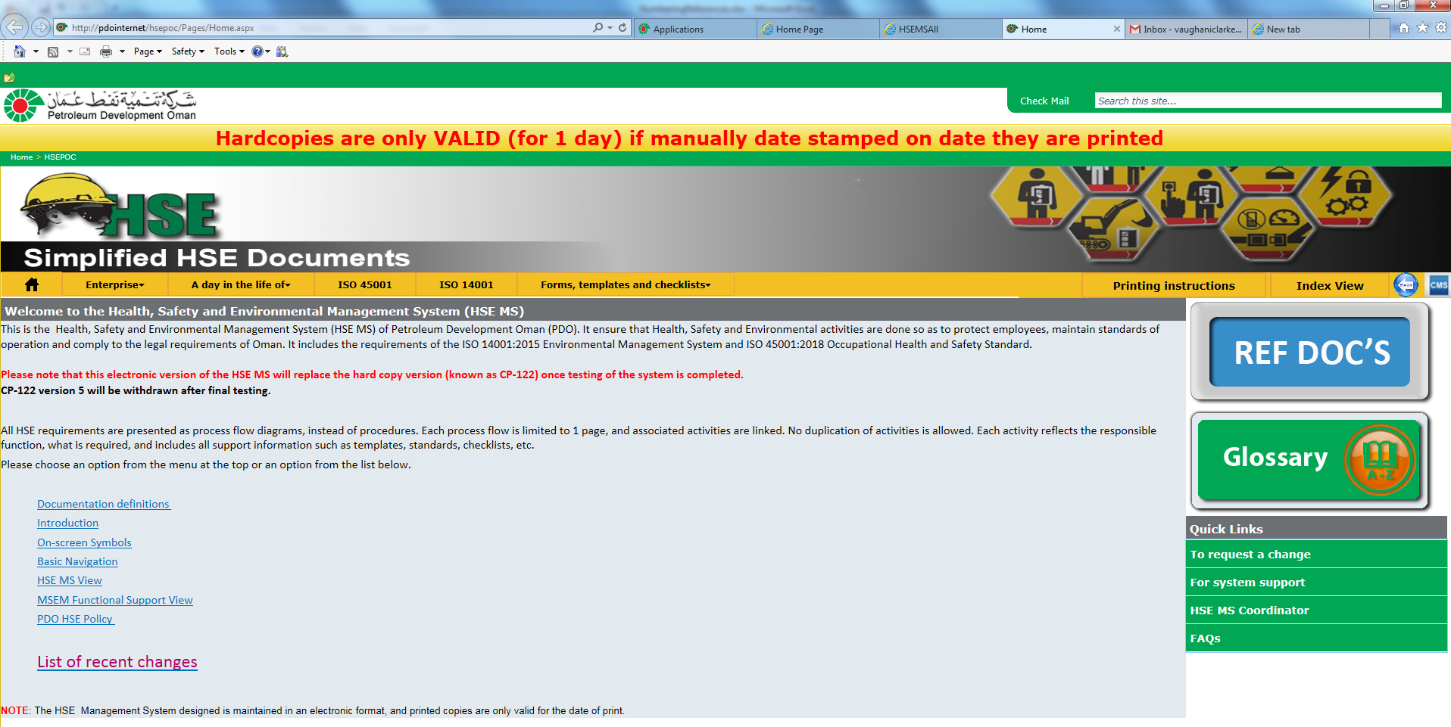
Where do you find the HSE-MS? (Contractors)
For PDO Employees, there is a link on the HSE website. This link will open the simplified HSE MS.
http://pdointernet/hseforcontractors/Index.aspx
For contractors there is a link on the HSE for Contractors website. This link will open the simplified HSE MS.
http://www.pdo.co.om/hseforcontractors/Index.aspx
The current procedures will remain available until 30 June 2018.
All users of the HSE MS to access and use the simplified HSE MS.
If you experience problems with the site, or find errors with links, or errors with some of the processes, you are requested to report these to the Document controller using the link on the website.

Slide 10
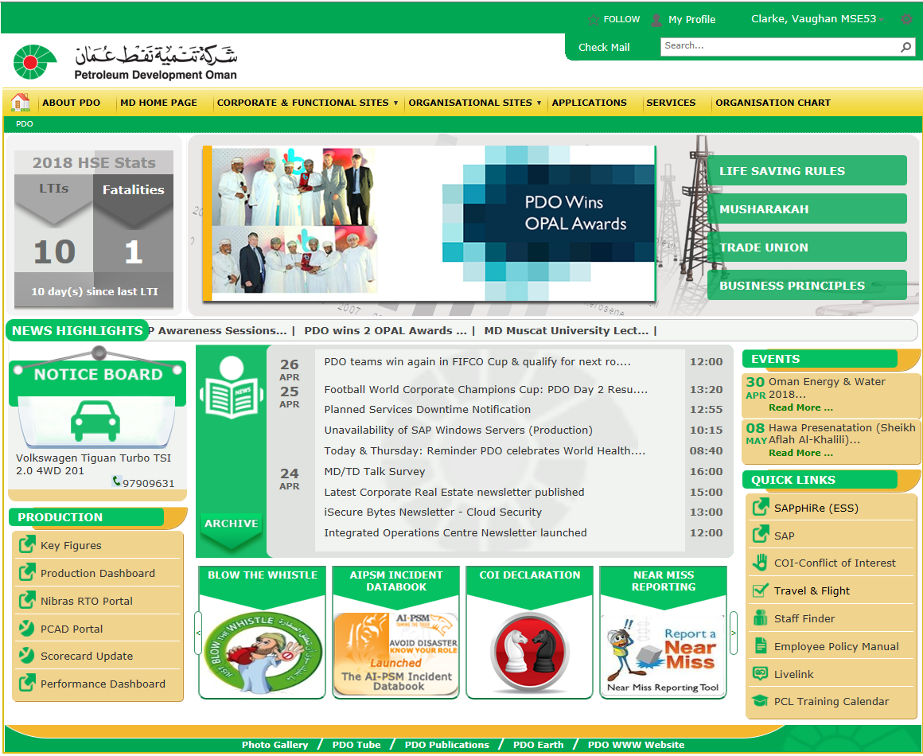
Where do you find the HSE-MS? (PDO)

Slide 11
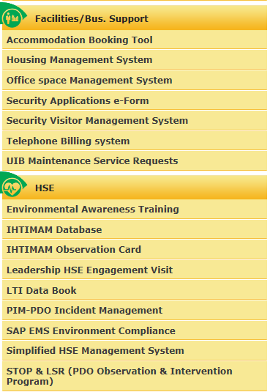
Where do you find the HSE-MS? (PDO)
New System

Slide 12
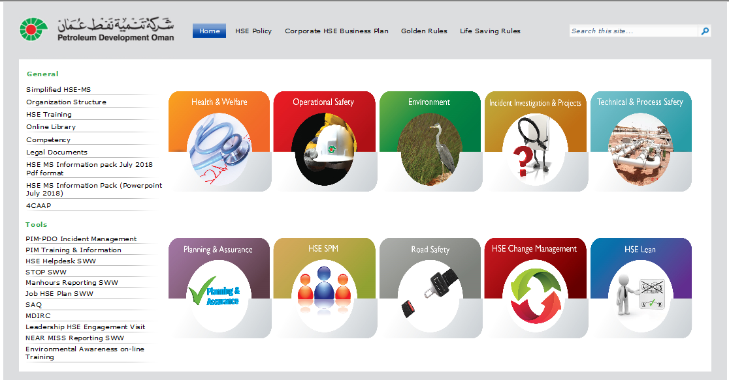
Where do you find the HSE-MS? (Contractors)
On the same page as old system
Select for New system

Slide 13
New System

Slide 14
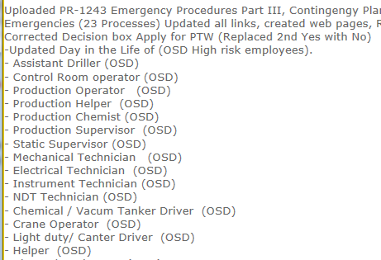
New System
This log allows quick check if any changes have occurred to your document

Slide 15
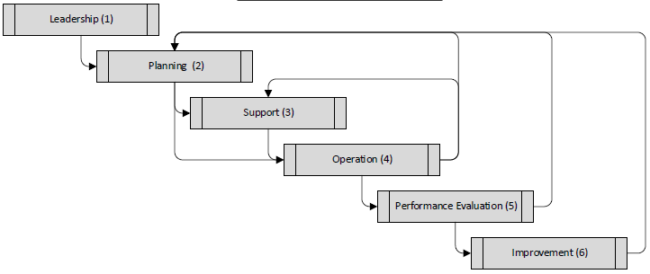
New System
HSE MS Now has 6 “NEW” elements
Leadership, Planning, ….

Slide 16
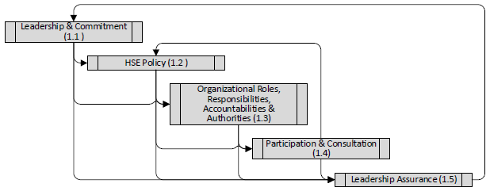
New System
Each element has different sub-elements, …

Slide 17
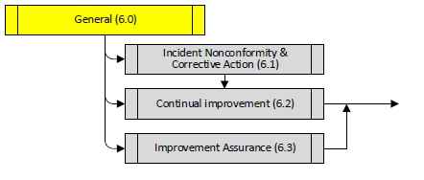
New System
Each element has different sub-elements, …

Slide 18
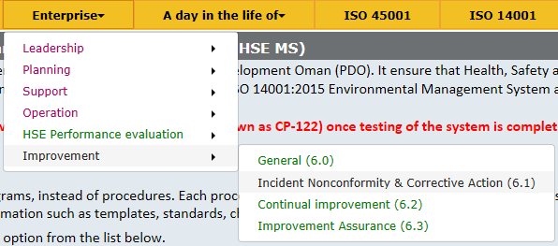
New System
HSE MS can be accessed from both access points and go to same place in system

Slide 19
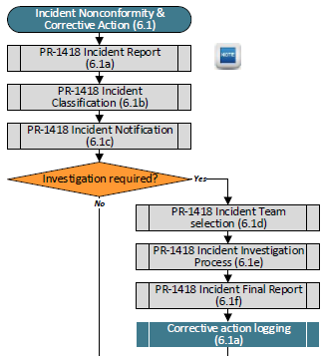
New System
Example : Incident nonconformity and corrective action PR-1418

Slide 20
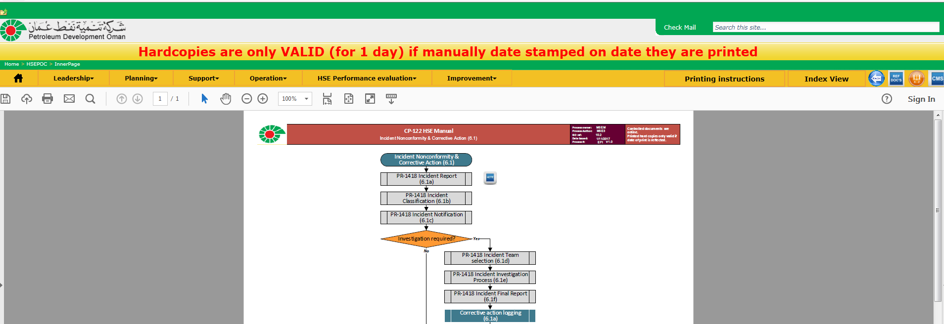
New System

Slide 21
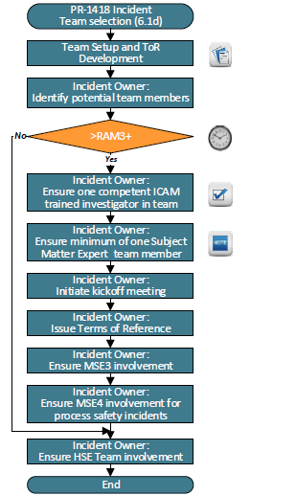
PR-1418 Example 1: Team selection
Blank Terms of Reference template
Who must do each activity
Checklist for competency
What must be done

Slide 22
New System

Slide 23
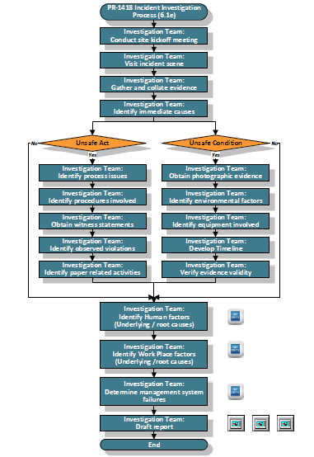
PR-1418 Example 2: Investigation
Steps to deliver investigation and who does what!
Immediate causes identification and evidence gathering
Root cause analysis ICAM Templates
System failure identification Templates
MDIRC Reporting templates

Slide 24
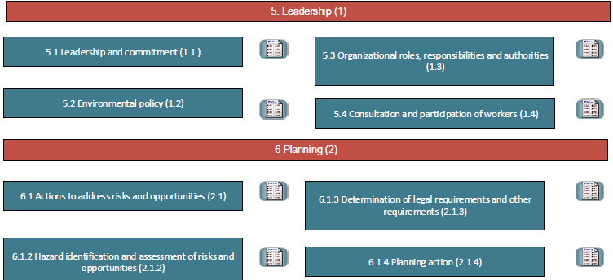
New System
ISO 45001 (Previously OHSAS 18001) Elements

Slide 25
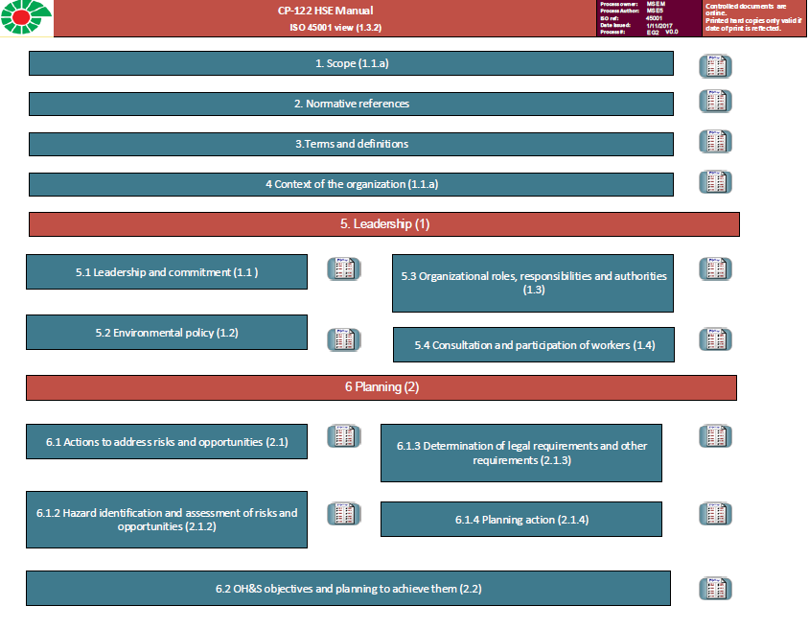
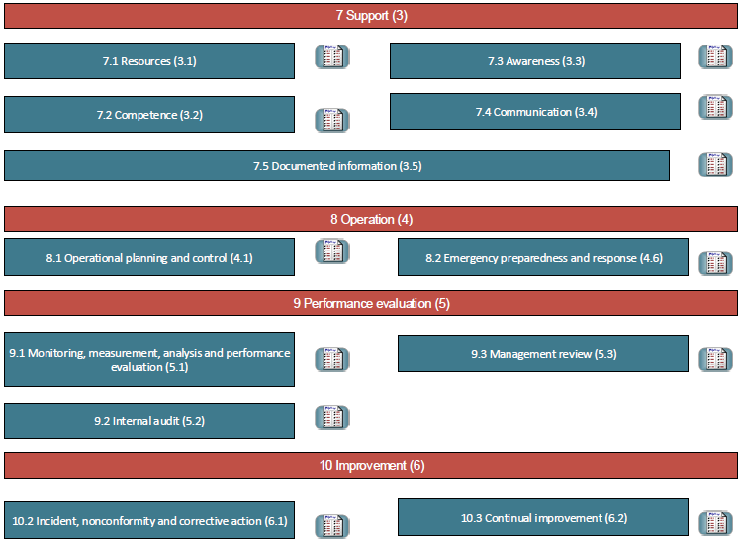
ISO 45001: 2017 Elements (Occupational Health & Safety Environment)
ISO 45001 Requires incident nonconformity reporting and investigation

Slide 26
New System
Arrive at same processes as Enterprise view!

Slide 27
New System
ISO 14001 Elements

Slide 28
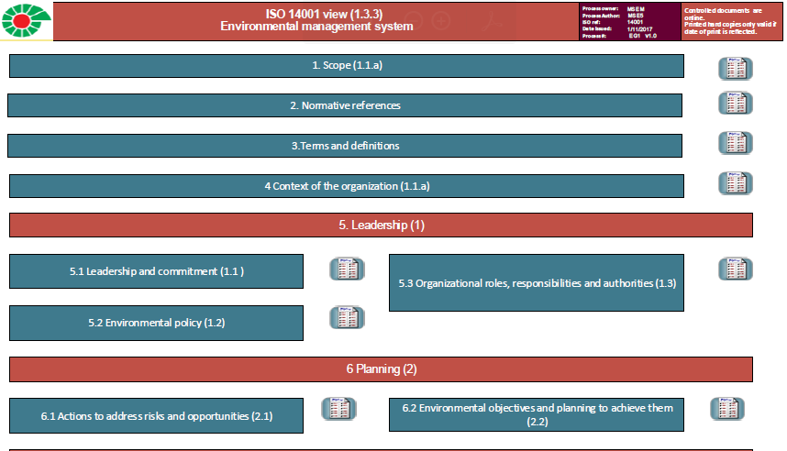
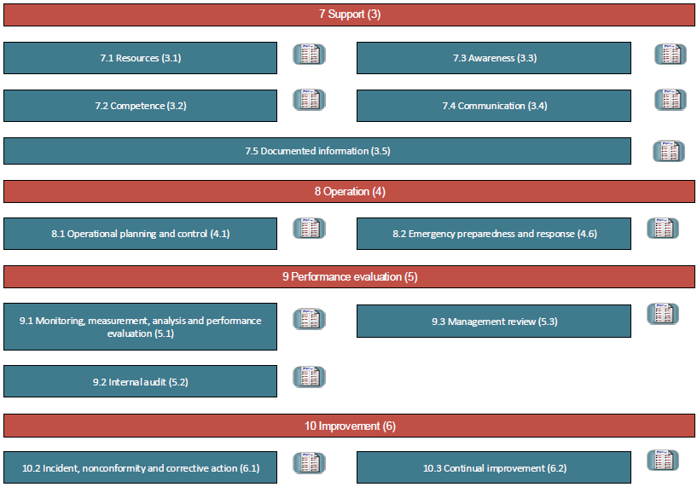
ISO 14001: 2015 Elements (Environment)
ISO 14001 Requires incident nonconformity reporting and investigation

Slide 29
New System
Arrive at same processes as Enterprise view!

Slide 30
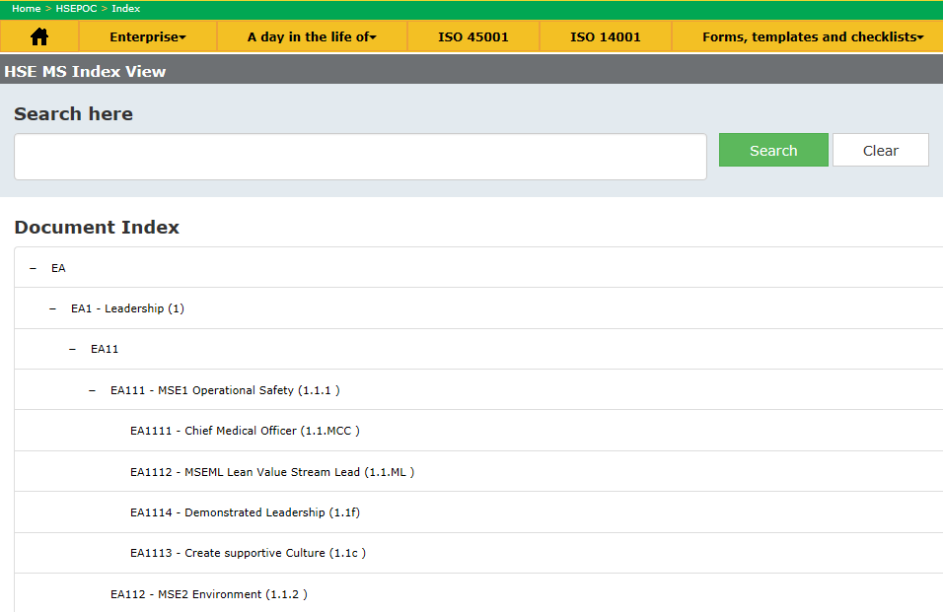
New System
2 other ways to find documents
“Search” for a document or
Lists all HSE MS doc’s

Slide 31
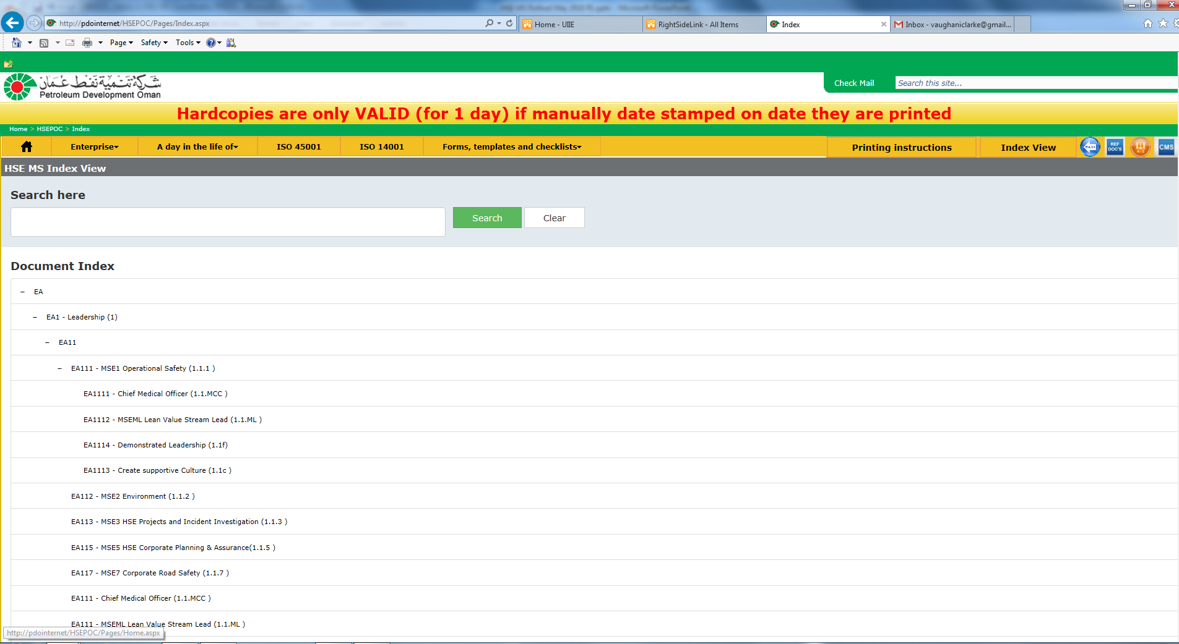
Either type in what you are looking for
Or scroll down until you find what you are looking for

Slide 32
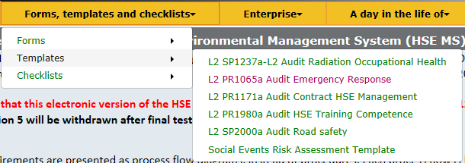
New System
Quick access to HSE Related forms, checklists & templates

Slide 33
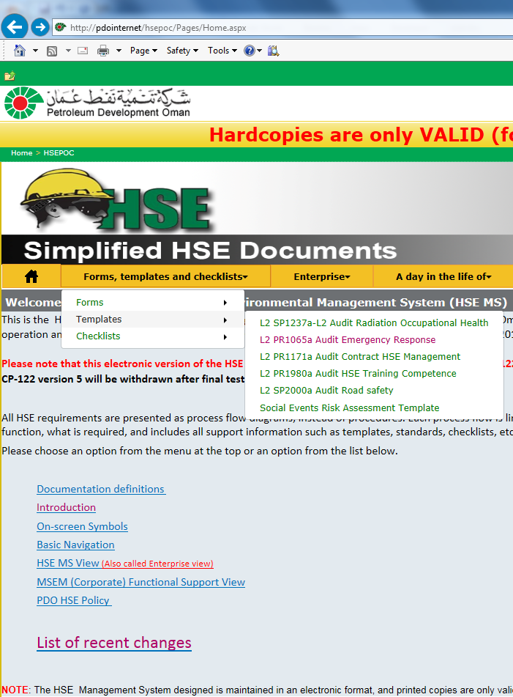
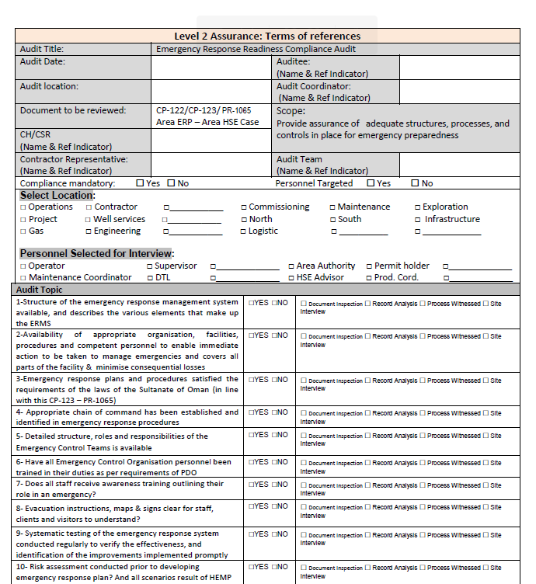

Slide 34
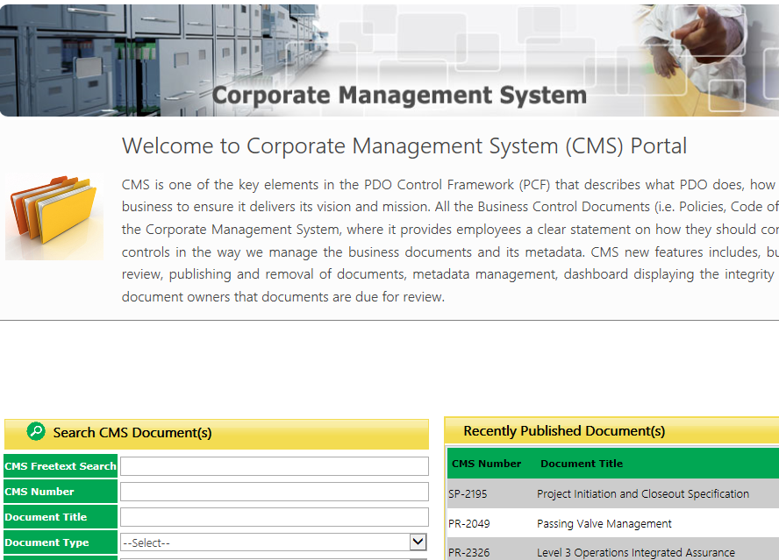
New System
This opens the Corporate management System (CMS) where Specifications are maintained. NOTE This is not available to contractors

Slide 35
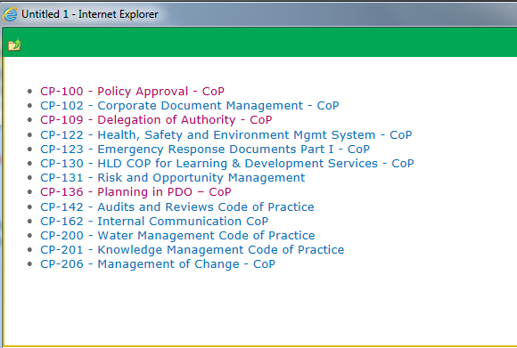
New System
Opens a list of the more important Codes of practice

Slide 36
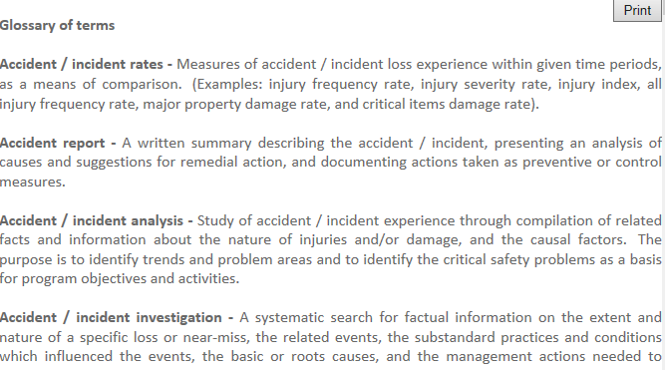
New System
This provides an in-house definition of the various HSE terms used

Slide 37
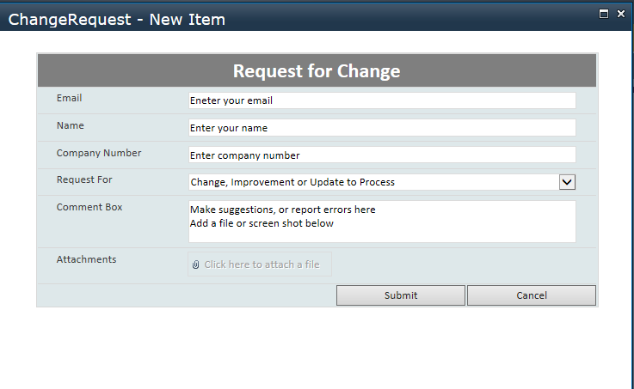
New System
This is where you make suggestions or report errors

Slide 38
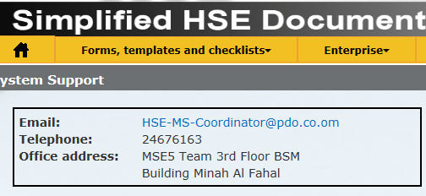
New System
Provides details for reporting or requesting support

Slide 39
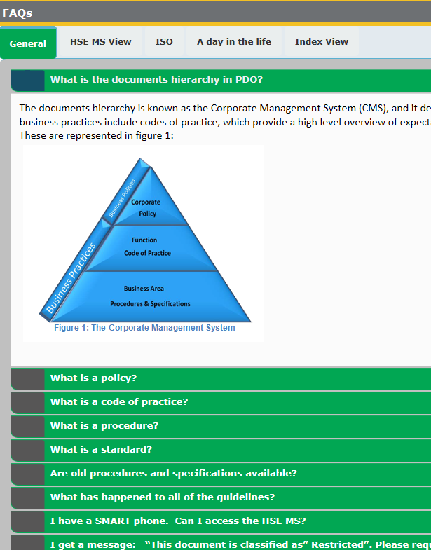
New System
A series of “Frequently asked questions” with answers

Slide 40
New System
Useful system information but not essential reading!

Slide 41
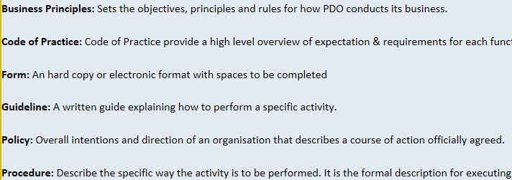
New System
See next slide for screen shot
Select to see what definitions are used in system

Slide 42
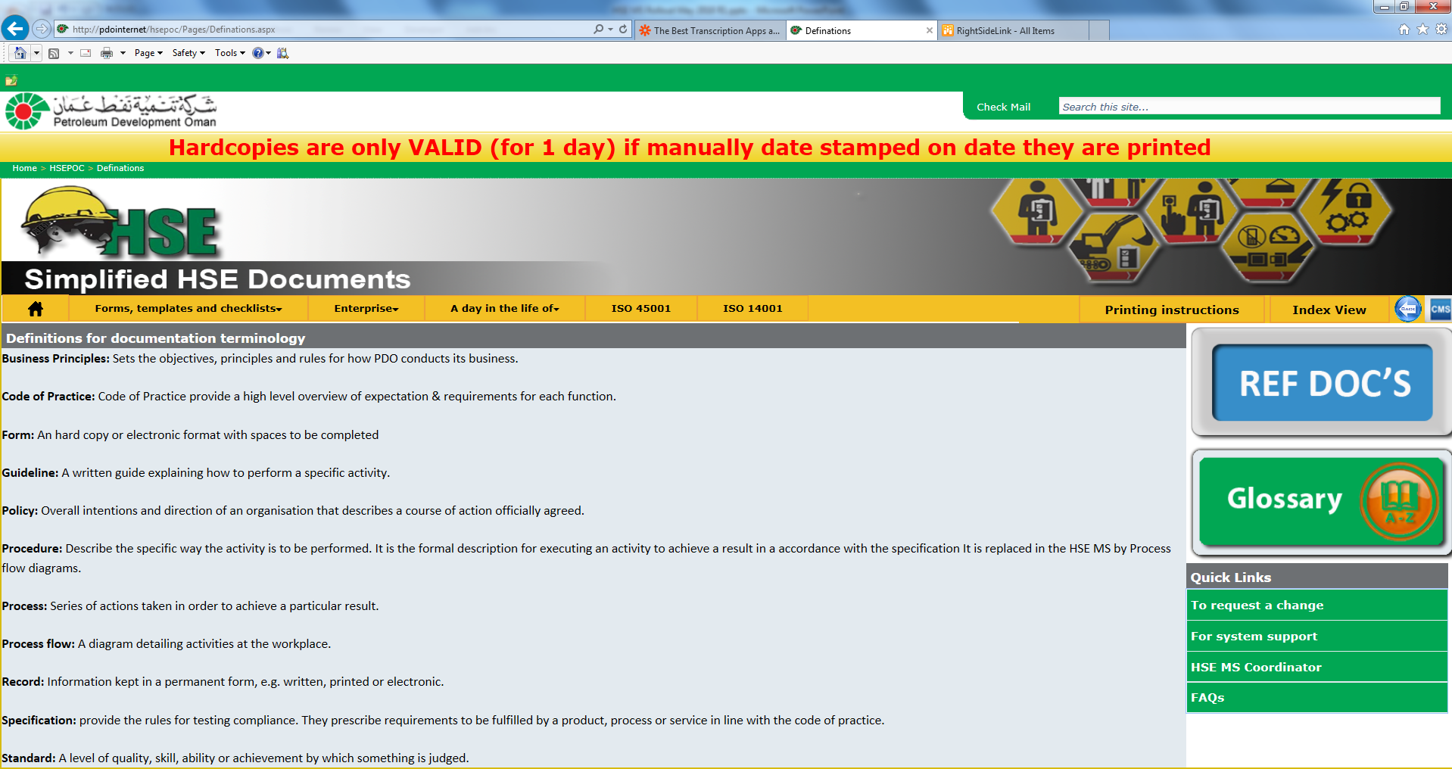
New System Definitions

Slide 43
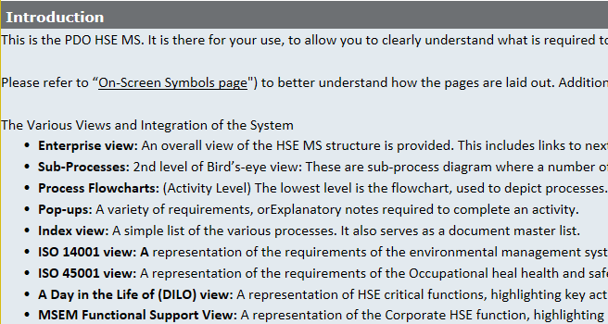
New System
See next slide for screen shot
Explains the parts of the system

Slide 44
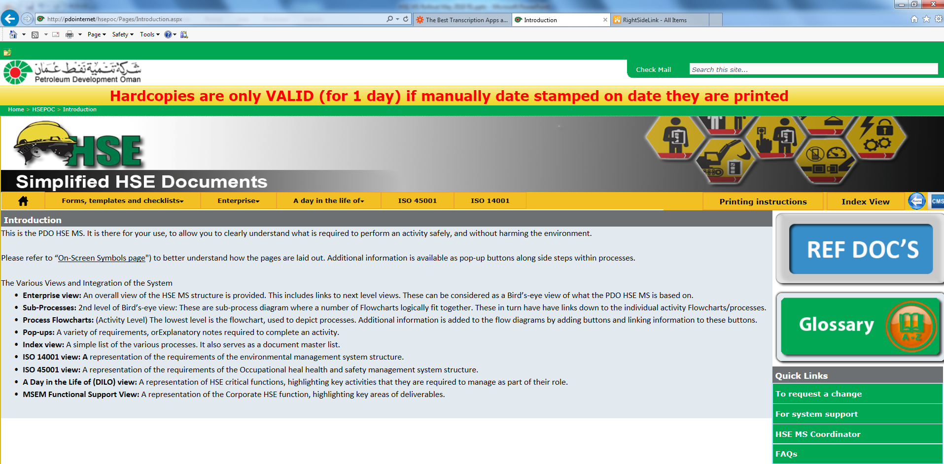
New System Introduction

Slide 45
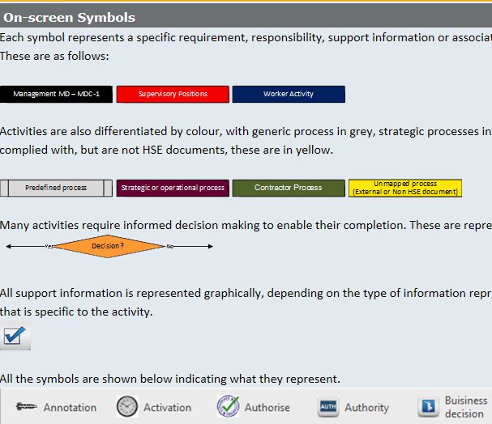
New System
Describes all the different boxes, buttons &symbols used in system

Slide 46
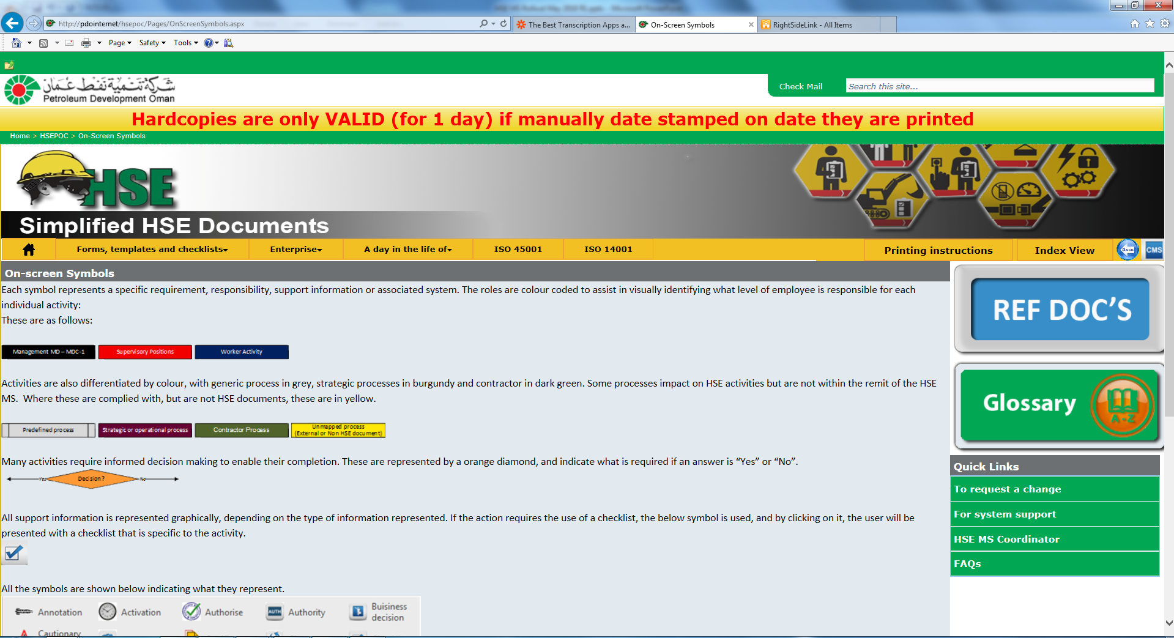
New System On-screen symbols
Activity done by Supervisor
Document not available in HSE MS
Decision required
Checklist needed to do activity, etc..

Slide 47
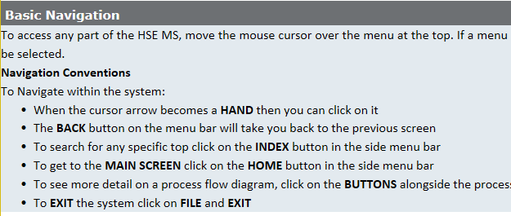
New System
Explains how to move around in system

Slide 48
New System
This button is a quick way to “Move” back 1 page only
Clicking in “hsepoc” will open home page

Slide 49
New System
HSE MS Now has 6 “NEW” elements

Slide 50
New System
Each element has different sub-elements, …

Slide 51
New System
Both points display HSE MS elements
The HSE MS can also be accessed from here!

Slide 52
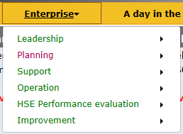
New System
Enterprise View (HSE MS Elements)
& sub-elements

Slide 53
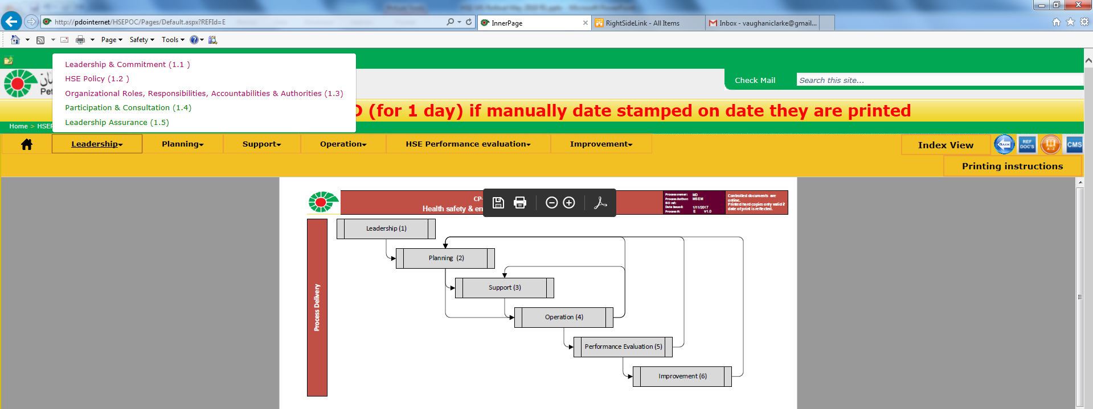
New System

Slide 54
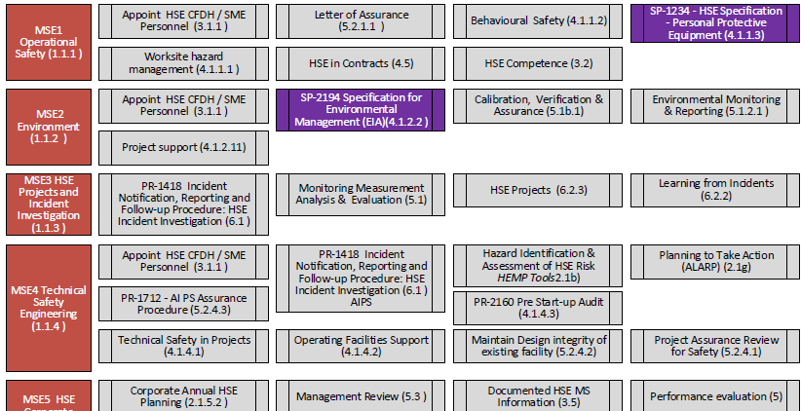
New System
This is how HSE Corporate supports line

Slide 55
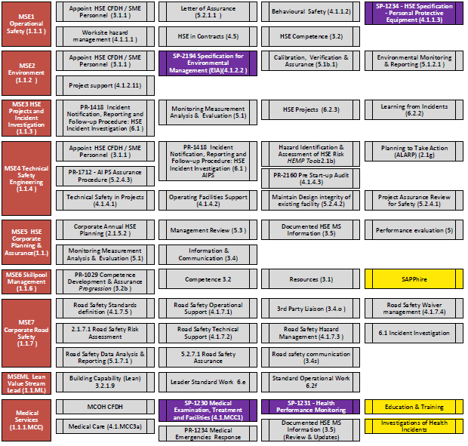
MSE1 Activities: Overall
MSE4 Activities: PR-2160 Pre-start up audits
MSE3 activities: PR-1418 Notification, reporting & follow-up procedure

Slide 56
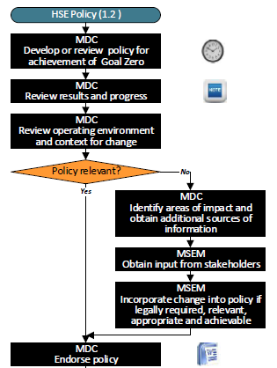
New System
This is how the HSE Policy is developed

Slide 57
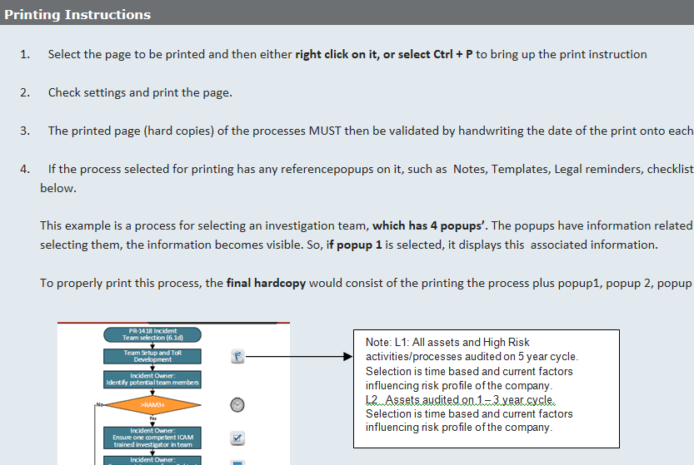
New System
Explains how to create a “Hard copy” of a screen

Slide 58
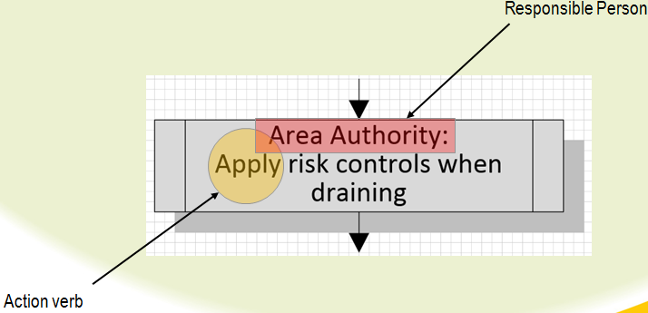
The Simplification Process
HSE-MS reduced to 6 management system elements (Called an Enterprise view)
Includes requirements of ISO 45001:2018 (H&S) and ISO 14001:2015 (Env).
HSE procedures revised into processes (Each process consists of an input, the actual activities for the process itself, and delivers an output.
Input and approval obtained from process owners (Content owners)
Each process fits on 1 page.
Each process limited to 16 activity blocks.
Activity wording per block limited to 12 words, including responsible person title.
Responsibility for each activity defined
Each activity block starts with an action verb
Processes converted to web data
Published on website

Slide 59
How to use the HSE-MS
Navigation
To access any part of the HSE MS, move the mouse cursor over the menu at the top.
If a menu item contains a sub-menu, moving the mouse over the item will immediately expand the menu displaying the sub-items.
Any sub-item can then be selected.
When the cursor arrow becomes a HAND then you can click on it
The BACK button on the menu bar will take you back to the previous screen
To search for any specific top click on the INDEX button in the side menu bar
To get to the MAIN SCREEN click on the HOME button in the side menu bar
To see more detail on a process flow diagram, click on the BUTTONS alongside the process blocks and text will pop up. Click outside the popup to CLOSE it.
To EXIT the system click on FILE and EXIT

