Slide 1
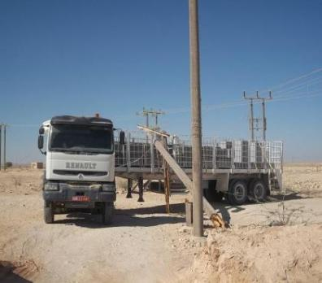
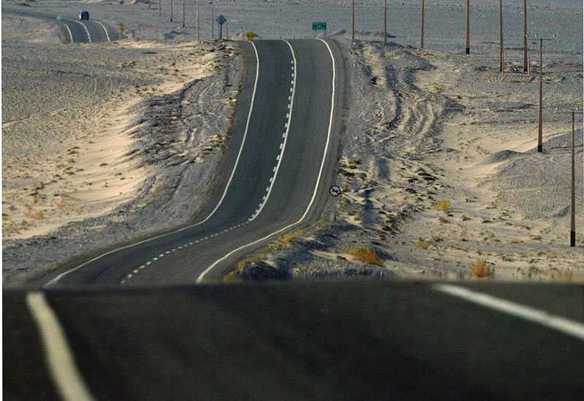
PDO safety advice
Use this Alert: Discuss in Tool Box Talks and HSE Meetings ➔ Distribute to contractors ➔ Post on HSE Notice Boards ➔ Include in site HSE Induction
Date : 18.03.2013 Lorry breaks high voltage pole
What happened?
A HGV driver driving a loaded 40 tonne articulated lorry decided to deviate from the planned route to meet up with his friend for personnel reasons. In doing so he had to turn near to a wooden pole carrying a 33 KV overhead line pole and a stay wire. As he made the turn the stay wire holding up the pole became snagged between his cab and the trailer. The driver reversed to release the wire however this increased the tension and the wire pulled on the pole and it snapped falling on the trailer. There were no injuries but the power supply to the camp area was cut off disrupted, pole destroyed and trailer damaged.
Your learning from this incident..
Works vehicles are not to be used for personal use.
Deviating from your route can lead to unforeseen hazards
Never underestimate the electrical hazard of a 33 KV power line.
Always check your mirrors when turning a HGV
Don’t deviate from the planned journey & authorised route
Contact: MSE54 for further information or visit the HSE Website Learning No 18 07/07/2013

Slide 2
Management learnings
Date : 18.03.2013
Lorry breaks high voltage pole
As a learning from this incident and ensure continual improvement all contract managers are to review their HSE HEMP against the questions asked below
Do you regularly give your drivers tool box talks and relate them to rule breaking?
Has your journey manager attended and passed the new SJM course?
Do you monitor your journey manager to ensure he is briefing the drivers on compliance?
Do you audit your journey management system as per the SP2000 v3?
Do you have an appointed person to control the SJM system?
Do you have IVMS fitted in all of your vehicles?
Do you randomly check the route taken by your vehicles via IVMS to ensure they comply with the routes to take?

