Slide 1
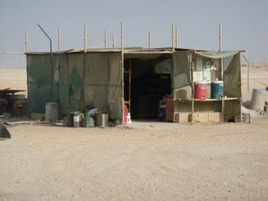
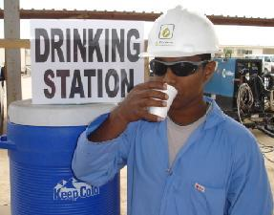
Shelters at Worksites
Working under direct sunlight for long periods may cause health complications. It is strongly advised to provide shaded shelters where employees can take a rest at suitable intervals.
The followings should be considered for the shelters:
Protection from direct sunlight
Ventilation
Drinking water
Obstacles-free
Chairs/bench
Sufficient space to accommodate the number of intended users
Please refer to :
Royal Decree No. 35/2003 (Chapter 4 / part 3) (Hours of Work)
SP-1231-Occupational Health under sections on heat and sunlight
Issued by MSE/5 (February 2014)

