Slide 1
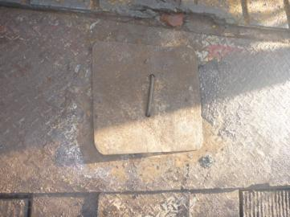
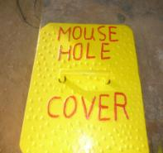
PDO Safety Advice
Use this Alert: Discuss in Tool Box Talks and HSE Meetings ➔ Distribute to contractors ➔ Post on HSE Notice Boards ➔ Include in site HSE Induction
Date: 9 Jan 2014
Injury: Deep laceration
What happened?
The driller stepped on the mousehole cover, which slipped and moved from its original position causing him to lose balance and his left leg partially slipped into the mousehole, resulting in injury.
Your learning from this incident..
Always watch your steps and be careful where you stand.
Apply the empowerment to stop when the job is unsafe.
Х
√
Use the correct mouse hole cover and ensure it is in good condition
Contact: MSE54 for further information or visit the HSE Website Learning No 02 09/01/2014

Slide 2
Management learning's
Use this Alert: Discuss in Tool Box Talks and HSE Meetings ➔ Distribute to contractors ➔ Post on HSE Notice Boards ➔ Include in site HSE Induction
Date: 9 Jan 2014
Injury: Deep laceration
As a learning from this incident and ensure continual improvement all contract
managers are to review their HSE HEMP against the questions asked below
Confirm the following:
Are all mouse hole covers properly fitted?
Does your JSA’s/procedures cover all risks and hazards?
Is the empowerment to stop process used effectively?
Is the alert/learning advice understood by the crew members?
Do you have a system to ensure actions from lateral Learning's are implemented.
Contact: MSE54 for further information or visit the HSE Website Learning No 02 09/01/2014

