Slide 1
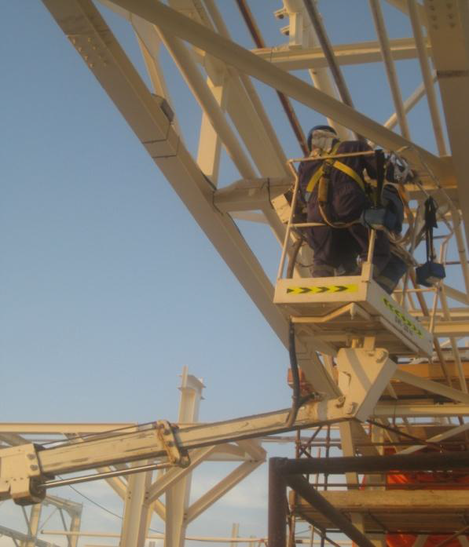
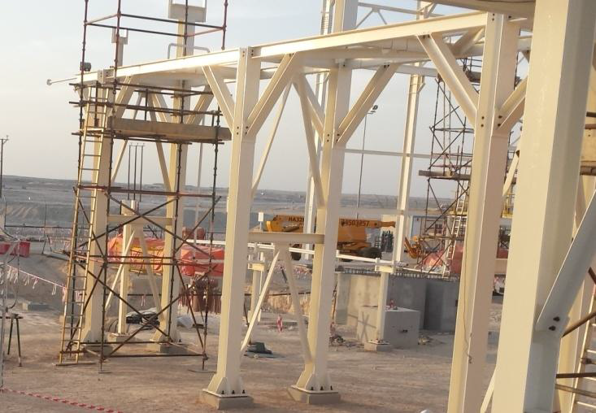
PDO Safety Advice
Use this Alert: Discuss in Tool Box Talks and HSE Meetings ➔ Distribute to contractors ➔ Post on HSE Notice Boards ➔ Include in site HSE Induction
Date: 04/03/2014
Injury: Fractured rib
What happened?
A Rigger and a Bucket Truck Operator was instructed to remove temporary wooden piping supports at a pipe rack manually using a handsaw. While attempting to position themselves to cut the support, accidently the control of the bucket was engaged by a strap of the safety harness of the rigger. The bucket moved and trapped the rigger between the guard rail of the bucket and the pipe rack structure, causing injury.
Your learning from this incident..
Make sure that you have sufficient room in your elevated bucket to execute the activity safely
Make sure the equipment pre-inspection check list is up to date, understood and followed
Make sure you are aware of your elevated bucket emergency lowering procedure
Apply the empowerment to stop when the job is unsafe
Always use the right means of access to execute activities at height safely
Contact: MSE54 for further information or visit the HSE Website Learning No 07 04/03/2014

Slide 2
Management learning's
Use this Alert: Distribute to contractors ➔ Discuss in HSE Meetings
Date: 04/03/2014
Injury: Fractured rib
As a learning from this incident and ensuring continual improvement, all contract managers are to review their HSE HEMP against the questions asked below .
Does the bucket truck emergency lowering procedure exist in your organization, where applicable?
Is the bucket truck emergency lowering procedure known and practiced by your crew member?
Does your HEMP capturing specific activates related to bucket truck equipment, and was it communicated effectively to the crew member i.e. operators and drivers?
Do you maintain your equipments operating manuals, instructions and maintenance records including bucket trucks? Are they available at site, and accessible to the end user i.e. operators?
Are the tools/equipment used for your activates appropriate for the assigned jobs?
Is the empowerment to stop unsafe acts/conditions effectively practiced?
Do you have a system to ensure actions from lateral Learnings are implemented.
Is the alert/learning advice understood by the crew members?
Contact: MSE54 for further information or visit the HSE Website Learning No 07 04/03/2014

