Slide 1
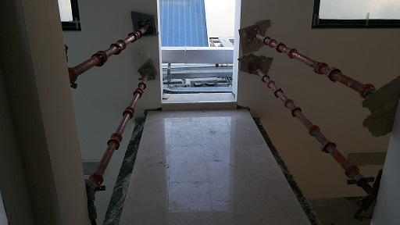
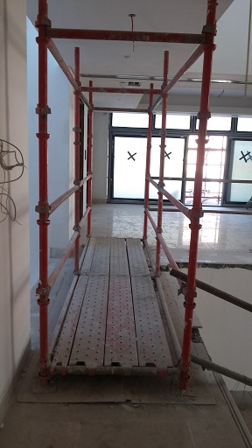
PDO Safety Advice
Use this Alert: Discuss in Tool Box Talks and HSE Meetings ➔ Distribute to contractors ➔ Post on HSE Notice Boards ➔ Include in site HSE Induction
Date: 26/02/2014
Injury: multiple fractures
What happened?
The electrician was working on a balcony situated at roof height and was protected from fall from height by barrier protection which had been fitted at the edge of the balcony. The electrician leaned against the barrier which gave way and he and the barrier fell 8.1 meters down to the ground below. He was transferred to Khoula hospital where he was admitted to intensive care. He sustained multiple fractures.
Your learning from this incident..
Employ competent personnel (CITB trained) for scaffolding works
Intervene on all unsafe conditions.
Never be complacent and be safe at height.
Follow right medical emergency procedure.
Follow working at heights procedures as per SP1257
Contact: MSE54 for further information or visit the HSE Website Learning No15 26/02/2014

Slide 2
Management learning's
Use this Alert: Distribute to contractors ➔ Discuss in Meetings
Date: 26/02/2014
Injury : Multiple fractures
As a learning from this incident and ensure continual improvement all contract
managers are to review their HSE HEMP against the questions asked below
Confirm the following:
Do you have sufficient competency in the requirements of SP1257?
Do you carry out risk assessment for all fall prevention measures?
Do you comply with contractual requirements for HSE competency and training?
Do you have effective incident management competency and skills?
Do you have a system to ensure actions from lateral Learnings are implemented?
Is the alert/learning advice understood by the crew members?
Contact: MSE54 for further information or visit the HSE Website Learning No15 26/02/2014

