Slide 1
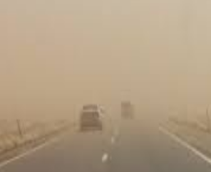
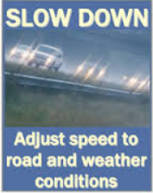
PDO Safety Advice
Use this Alert: Discuss in Tool Box Talks and HSE Meetings ➔ Distribute to contractors ➔ Post on HSE Notice Boards ➔ Include in site HSE Induction
Date: 13.03.2014
Injury: Vertebral fracture
What happened?
A truck driver lost control of his truck and drove into a stretch of multiple sand bars that had formed half way across the road, due to poor visibility caused by sandy wind. The vehicle steered-off the road and ended down an incline adjacent to the right side of the road. The vehicle was stopped by a heap of sand that had composed in that area.
Your learning from this incident..
Stick to the basics of defensive driving, where you should stop or slow down the vehicle under deteriorate weather condition.
Ensure a proper vehicle inspection is carried out prior to the journey and recorded in the vehicle checklist.
You’re Empowered to STOP if not Safe
Insert wrong picture here
Adjust speed to road and weather conditions, always apply Defensive Driving Techniques
Contact: MSE54 for further information or visit the HSE Website Learning No 18 13/03/2014

Slide 2
Management learning's
Use this Alert: Distribute to contractors ➔ Discuss in Meetings
Date: 13.03.2014
Injury: Vertebral fracture
As a learning from this incident and ensure continual improvement all contract
managers are to review their HSE HEMP against the questions asked below
Confirm the following:
Do you check the effectiveness of your journey management communication between the drivers and journey manager ?
Do all your journey manager have a valid JM certificate?
Are all vehicles in your fleet equipped with IVMS system?
Do you conduct drivers forum, drivers engagement on different subjects i.e application of DD techniques and empowerment to stop e.g. reverse weather conditions ?
Do you counsel your drivers on their IVMS-RAG report ?
Is a proper vehicle inspection carried out prior to the journey, and recorded in the vehicle checklist?
Does your sub contractor have an audit procedure/ program for their sub contractor?
Do you have a system to ensure actions from lateral Learnings are implemented?
Is the alert/learning advice understood by the crew members?
Contact: MSE54 for further information or visit the HSE Website Learning No 18 13/03/2014

