Slide 1
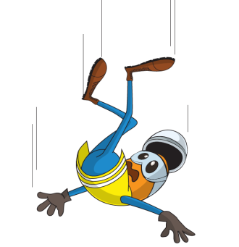
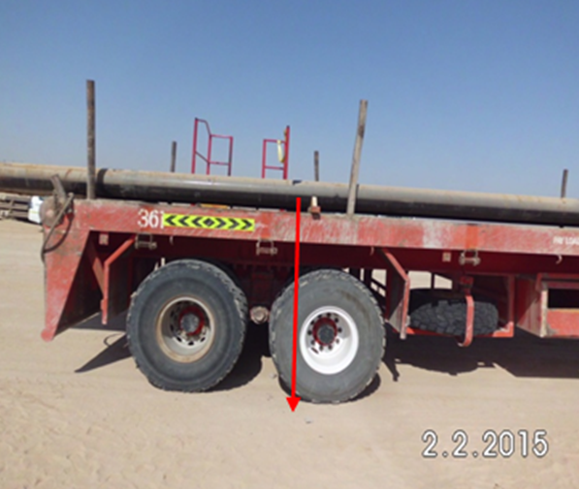
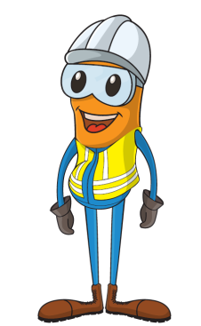
PDO Incident First Alert
Incident type | LTI(#04) | PIM ID | 1088446
Date/ time | 02/02/2015 (10:15 hrs) | Directorate
Location | Fahud casing yard | Dept
What happened
A 27 year old yard crewman was standing on top of casings on a 40 foot trailer whilst he rammed in chocks to secure the dunnage. He felt dizzy, lost his balance and fell 1.8m to the ground. He painfully fractured his right wrist and grazed his face and leg.
Mr. Musleh asks the questions of can it happen to you?
Do you ever stand on casing’s at height?
What would you do if suffered with dizziness?
How else can chocks be wedged safely?
Could he have done it from the ground?
Please disseminate this LTI notification to your teams and use it in your tool box talks and HSE meetings and notice boards.

