Slide 1
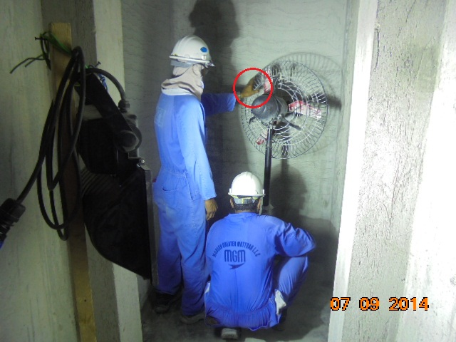
PDO Safety Advice
Use this Alert: Discuss in Tool Box Talks and HSE Meetings ➔ Distribute to contractors ➔ Post on HSE Notice Boards ➔ Include in site HSE Induction
Date:04/09/2014
Injury: thumb amputation
What happened?
A contractor engaged in masonry work, was injured while he tried to redirect the air flow of a rotating pedestal fan.
His left hand thumb came in contact with the rotating fan blade through the protective cage which lead to amputation of tip of the left hand thumb.
Your learning from this incident:
Inspect all tools, plant and equipment prior to mobilization and periodically thereafter.
Switch off power supply before handling any power tool, plant / equipment.
Never use any unauthorized tool, plant / equipment.
X
Switch off power supply before handling any power tool.
Contact: MSE34 for further information Learning No 49 04/09/2014

Slide 2
Management learning's
Distribute to contractors ➔ Post on HSE Notice Boards
Date: 04/09/2014
Injury: thumb amputation
As a learning from this incident and ensure continual improvement all contract
managers are to review their HSE HEMP against the questions asked below
Confirm the following:
1) Did you have warning signs on rotating equipment?
2) Do you have effective controls in place to prevent access to moving parts?
3) Do you have a system for safety records?
Contact: MSE34 for further information Learning No 49 04/09/2014

