Slide 1
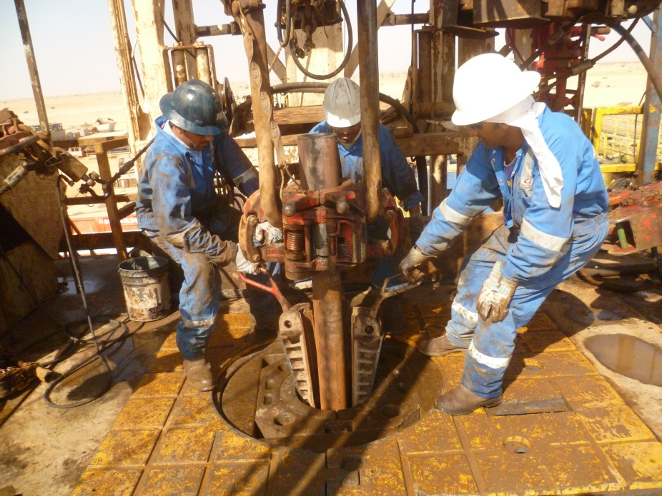
PDO Safety Advice
Use this Alert: Discuss in Tool Box Talks and HSE Meetings ➔ Distribute to contractors ➔ Post on HSE Notice Boards ➔ Include in site HSE Induction
Date: 10/09/2014
Injury: Fractured fingers
What happened?
Whilst the crew were running drill pipe in the hole the roustabout held a slip by its handle in order to set the drill pipe in the hole. When the driller lowered the drill pipe, the body of the elevator dropped down onto the handle of the slip and trapped two fingers of the roustabout’s right hand causing them to fracture.
Your learning from this incident..
Always inspect your tools and ensure they work correctly.
Green hats employees to be adequately supervised.
Ensure empowerment to STOP is understood and exercised.
Check & avoid potential Pinch points
Contact: MSE34 for further information Learning No 50 10/09/2014

Slide 2
Management learning's
Distribute to contractors ➔ Post on HSE Notice Boards
Date: 10/09/2014
Injury: Fractured fingers
As a learning from this incident and ensure continual improvement all contract
managers are to review their HSE HEMP against the questions asked below
Confirm the following:
How do you manage a shortage in your crew?
Do you inspect your tools before use?
Do you allow Green Hands on the rig floor?
Do you audit Green Hat Program?
Do you audit your incident reporting procedure?
How do you enforce the incident reporting procedure?
Do you allow to use private vehicle in emergency?
Contact: MSE34 for further information Learning No 50 10/09/2014

