Slide 1
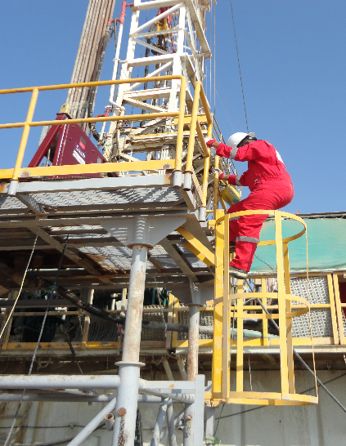
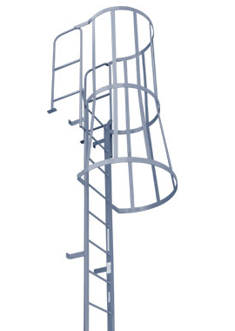
PDO Safety Advice
Use this Alert: Discuss in Tool Box Talks and HSE Meetings ➔ Distribute to contractors ➔ Post on HSE Notice Boards ➔ Include in site HSE Induction
Date: 14/11/2014
Injury: Leg fracture
What happened?
While centrifuge operator was climbing down from the centrifuge skid through the fixed ladder cage he lost his balance and slipped and fell to the ground from height of approx. 1.7 m. The operator received injuries to his right lower leg.
Your learning from this incident..
Always recognize slip/trip hazards while using ladders.
Ladder must not be used on if not free of grease, mud or water .
Always should have 3 points of contact while using the ladder.
Make sure bottom section and top section of the telescopic skid ladder are aligned.
❒
Always check condition of the ladder and boots before stepping on the ladder
Contact: MSE34 for further information Learning No 56 14/11/2014

Slide 2
Management learning's
Distribute to contractors ➔ Post on HSE Notice Boards
Date: 14/11/2014
Injury: Leg fracture
As a learning from this incident and ensure continual improvement all contract
managers are to review their HSE HEMP against the questions asked below:
Confirm the following:
How can we make sure all operators are trained and competent to carry out the job?
What kind of training and support the operator receives to ensure his safety while completing his task?
Contact: MSE34 for further information Learning No 56 14/11/2014

