Slide 1
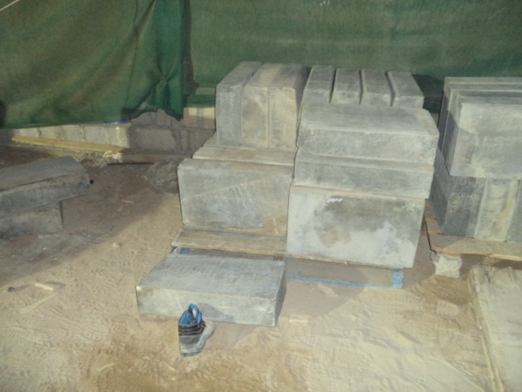
PDO Safety Advice
Use this Alert: Discuss in Tool Box Talks and HSE Meetings ➔ Distribute to contractors ➔ Post on HSE Notice Boards ➔ Include in site HSE Induction
Date:24/11/2014
Injury: Foot fracture
What happened?
IP along with three other day shift workers were working overtime, shifting and stacking curb stones. There was no supervisor available at the start of the task due to change over meeting and the workers did not attend the night shift TBT. Whilst adjusting one of the curb stones situated on the second layer of a wooden pallet, the IP placed his left foot on the previously stacked curbstones at the edge of the first layer. While removing his leg, it knocked the curb stone on the edge of the first layer off balance. This stone fell onto the IP’s right foot resulting in a fractured foot.
Your learning from this incident:
Ensure to attend TBT/TRIC for all workers before duties.
Supervisors should ensure their team has been handed over to the next supervisor before leaving duty.
Perform the work with proper supervision only.
Deploy the workers on extended hours with prior permission.
Avoid double handling of heavy materials.
Tie up the materials and avoid stacking in layers.
Proper supervision and proper Risk assessment TRIC for the work
Contact: MSE34 for further information Learning No 57 24/11/2014

Slide 2
Management learning's
Distribute to contractors ➔ Post on HSE Notice Boards
Date:24/11/2014
Injury: Foot fracture
As a learning from this incident and ensure continual improvement all contract
managers are to review their HSE HEMP against the questions asked below:
Is the leadership on shift aware of all workers and works ongoing?
Is there an effective procedure for hand over of shifts?
Is there an effective procedure in place for ensuring all workers attend TRIC?
Contact: MSE34 for further information Learning No 57 24/11/2014

