Slide 1
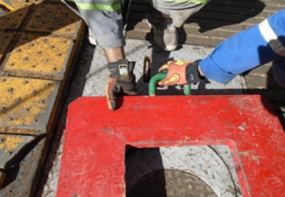
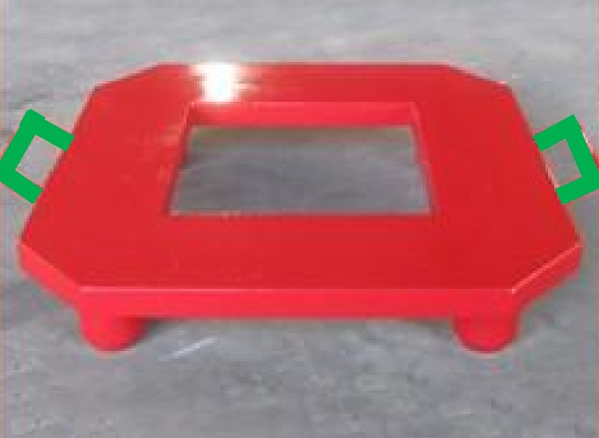
PDO safety advice
Use this Alert: Discuss in Tool Box Talks and HSE Meetings ➔ Distribute to contractors ➔ Post on HSE Notice Boards ➔ Include in site HSE Induction
Date: 16/12/2014
Injury: Finger Fracture
What happened?
During the locating of the Bit Breaker Tool into the slots on the Rotary Table, the IP (who was meant to be observing only) assisted from behind the two crew (Night Tool Pusher & Derrick Man) who were carrying out this task. As the Bit Breaker Tool located it caught the IP between the tool and the Rotary Table, resulting in the IP fracturing a finger and requiring eight stitches.
Your learning from this incident..
Must include “Stop the Job Triggers” in each Tool Box Talk.
Supervisors to step back and supervise
Any change to the plan – Stop and Manage the Change.
If you are not involved in the job, stand back and do not get involved.
If it looks wrong, it probably is – everyone one has the right to Stop the Job
Use the handles (painted green) ONLY
If it looks wrong – STOP the Job!
Contact: MSE34 for further information Learning No 58 16/12/2014

Slide 2
Management learning's
Distribute to contractors ➔ Post on HSE Notice Boards
Date: 16/12/2014
Injury: Finger Fracture
As a learning from this incident and ensure continual improvement all contract
managers are to review their HSE HEMP against the questions asked below
Confirm the following:
Do your tool box talks include stop the job triggers?
When a crew member leaves or joins the job task which has already started – how do your supervisors handle the change?
What is your Company Green Hand Policy (time based or competency based) ?
Are Green Hand Roustabouts allowed on your drill floor?
Supervisors / Managers – hands on or step back?
Contact: MSE34 for further information Learning No 58 16/12/2014

