Slide 1
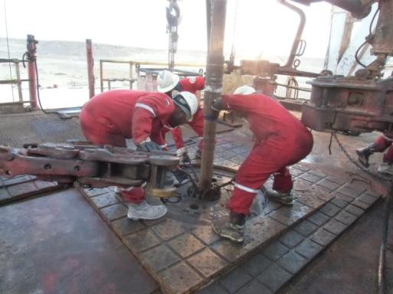
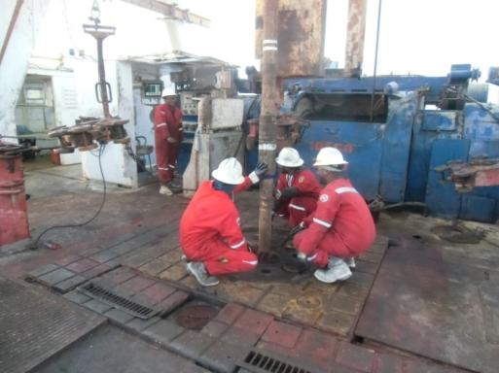
PDO safety advice
Use this Alert: Discuss in Tool Box Talks and HSE Meetings ➔ Distribute to contractors ➔ Post on HSE Notice Boards ➔ Include in site HSE Induction
Date: 25/12/2014
Injury: Right Thumb Fracture
What happened?
During picking up & Running in hole of 5" DP, Derrick man was picking up slips along with other two Floor man, the break out tong was coming in IP’s way while lifting the slips, he held his right hand in between the tongs open jaws in the process the tong jaws closed and crushed his right thumb.
Your learning from this incident..
Keep all your body part clear from crush point.
Use of short line for tong racking back hook.
Green handles are to be used while using or holding tongs.
Ensure that work procedures are fully understood and communicated to all involved in carrying out the job.
Stay clear from crush point - Always hang up the tong after use or after connection using proper short line.
Contact: MSE34 for further information Learning No 61 25/12/2014

Slide 2
Management learning's
Distribute to contractors ➔ Post on HSE Notice Boards
Date: 25/12/2014
Injury: Right Thumb Fracture
As a learning from this incident and ensure continual improvement all contract
managers are to review their HSE HEMP against the questions asked below
Confirm the following:
Are your crews using only the green handles provided on the tongs?
Do you have system in place to ensure that all the crew have attended the TBT and discussed JSA/SOP for the day.
Have you already introduced High impact Gloves to your crew?
Contact: MSE34 for further information Learning No 61 25/12/2014

