Slide 1
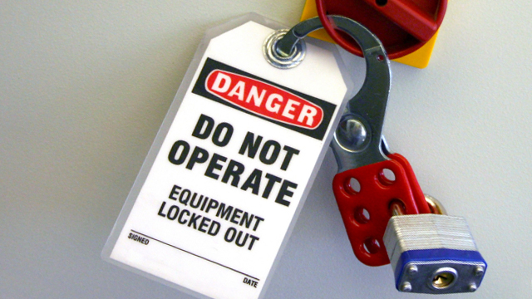
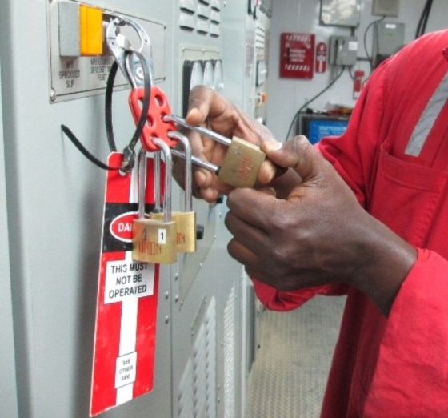
PDO Safety Advice
Use this Alert: Discuss in Tool Box Talks and HSE Meetings ➔ Distribute to contractors ➔ Post on HSE Notice Boards ➔ Include in site HSE Induction
Date: 31/03/2014
Injury: Leg and Hand fracture
What happened?
A Derrick Man struck by a rotating pony rod bar which was left on a Mud Pump after maintenance.
Your learning from this incident…
Ensure work areas are safe before commencing operations.
Ensure lock out & tag out system is implemented by applying 3 padlocks.
Always make sure that Original Equipment Manufacturer (OEM) tool is used to rotate the pony rod bar and never use/accept home made tools.
Ensure that sufficient lighting is available in work areas
Always make sure that pony rod bar is removed prior to operating the mud pump
One Pad-Lock
Do not de-isolate mud pump until pony rod bar is removed and all safety precautions are taken
Must be
3 Pad-Lock
Contact: MSE54 for further information or visit the HSE Website Learning No21 31/03/2014

Slide 2
Management learning's
Use this Alert: Distribute to contractors ➔ HSE Meetings
Date: 31/03/2014
Injury: Leg and Hand fracture
As a learning from this incident and ensure continual improvement all contract
managers are to review their HSE HEMP against the questions asked below
Confirm the following:
Do you have requirement to inspect the work site on completion of the job?
Do you have isolator available in night shift?
Are junior mechanic / electrician aware about PTW & Lock Out & Tag Out (LOTO) requirement?
Do you ensure that task relevant Job Safety Analysis (JSA) / Drilling Operation Procedure (DOP) are communicated to all involved personnel?
Do you have a system to ensure actions from lateral Learnings are implemented?
Is the alert/learning advice understood by the crew members?
Contact: MSE54 for further information or visit the HSE Website Learning No21 31/03/2014

