Slide 1
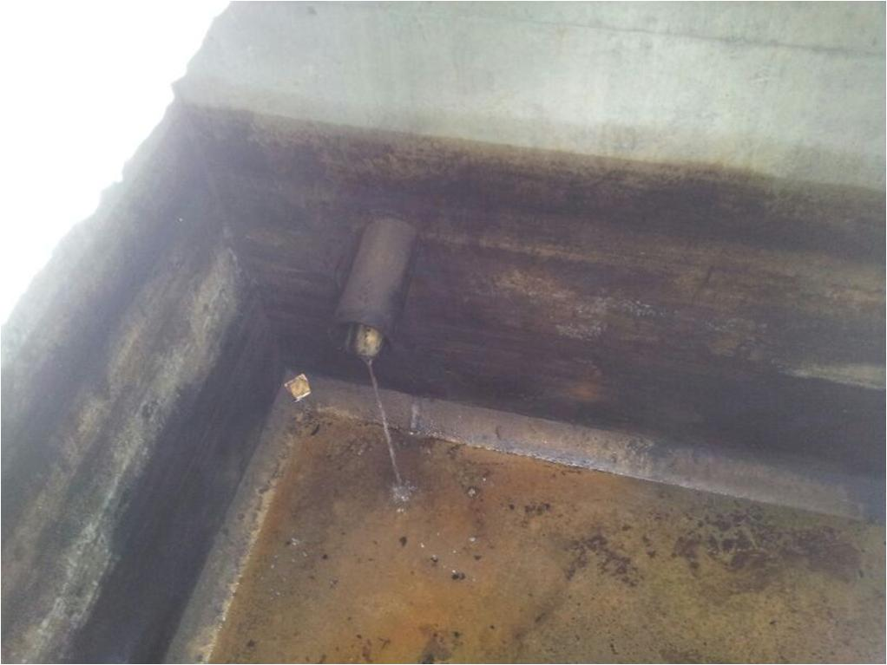
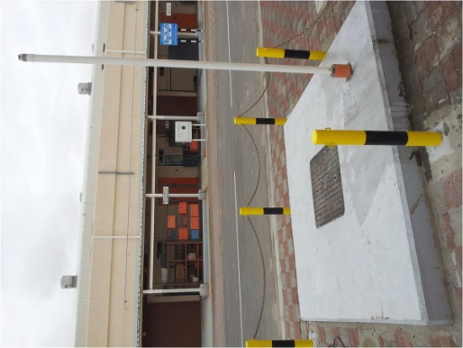
PDO Safety Advice
Use this Alert: Discuss in Tool Box Talks and HSE Meetings ➔ Distribute to contractors ➔ Post on HSE Notice Boards ➔ Include in site HSE Induction
Date: 23/03/2014
Chemist suffering a chemical burning of the eyes
What happened?
A build up of gases in a chemical drain pit blew out a drain cover in the floor of a lab spraying a chemist with hazardous chemicals in his eyes after the force of the blast blew off his safety glasses.
Your learning from this incident..
If your drains are making a funny noise do not ignore.
If your drains are smelling strangely, do not ignore.
Proper laboratory design is a must!
Contact: MSE54 for further information or visit the HSE Website Learning No17 23/03/2014

Slide 2
Management learning's
Use this Alert: Distribute to contractors ➔ HSE Meetings
Date: 23/03/2014
Chemist suffering a chemical burning of the eyes
As a learning from this incident and ensure continual improvement all contract managers are to review their HSE HEMP against the questions asked below
Do you make sure any new designs comply with DEPs and PDO specifications?.
Do you have a system to ensure actions from lateral Learnings are implemented?.
Is the alert/learning advice understood by the crew members?.
Contact: MSE54 for further information or visit the HSE Website Learning No17 23/03/2014

