Slide 1
Safety work-stoppage
April 2015

Slide 2
Safety work-stoppage
A VERY DISTURBING CHAIN OF EVENTS
PDO & its contractors have suffered THREE high potential incidents involving cold cutting in the last TWO months.
NOW IS NOT THE TIME
FOR COMPLACENCY

Slide 3
Cold cutting incidents
1
A contractor was dismantling a redundant flow line when one of its operators placed the cold cutter on the wrong / pressurised line.
(1st February 2015)
2
As part of shutdown activities a contractor was performing cold cutting on a 12” HP wet gas pipeline, as the operator was about to finish cutting through the pipe, pressurized gas (estimated at between 5-10 bar) was released from the cutting point hitting and causing him to fall to the ground with injuries to his face.
(4th March 2015)
3
A contractor was engaged in cleaning operations when the Permit Holder decided to cold cut a redundant line (not mentioned in the PTW) however, the crew placed the cutter on the wrong line causing damage to the line.
(29th March 2015)

Slide 4
1
Contractor places cold cutter on wrong pressurised line
Learning from Incidents
For PDO staff and contractors
A contractor was dismantling a redundant flow line when one of its operators placed the cold cutter on the wrong / pressurised line.
(1st February 2015)

Slide 5
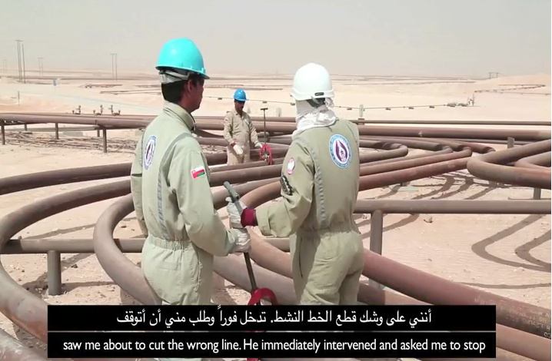
1
Contractor places cold cutter on wrong pressurised line
What happened :
On 1st February 2015 at approximately 0800 hours a crew was involved in a high potential cold-cutting incident, in Yibal Area.
The crew was mobilised to continue the dismantling of the remaining section of the redundant Y-514 flow line that was partially completed in previous days. The work started after the morning Tool Box Talk when the fitter placed the cold cutter on the wrong / pressurised section of the newly replaced flow line and started cutting the line. Immediately, a member of the second crew intervened to STOP the activity when he realized the cutter had been placed on the wrong flow line.
The cut mark depth on the flow line was found to be ~ 0.5mm of the 4.8mm wall thickness.

Slide 6
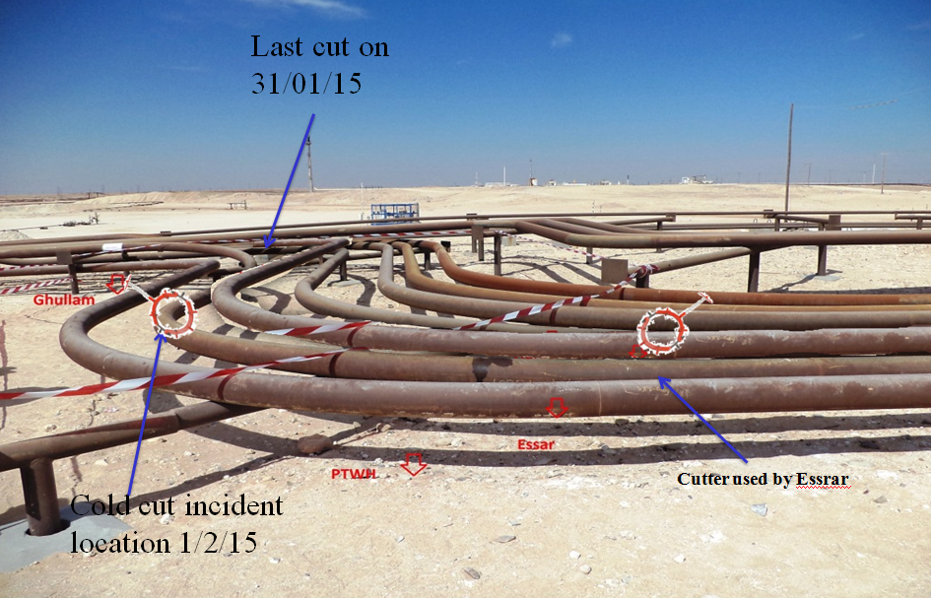
1
Contractor places cold cutter on wrong pressurised line
Why do we think it may have happened?
Fitter failed to follow the marking marked for cold cutting.
The fitter could not distinguish between the lines (the redundant and live line).
The supervisor did not confirm that the crew has placed the cutter on the required line prior to cutting.

Slide 7
2
Contractor operator cuts through pressurised gas line
Learning from Incidents
For PDO staff and contractors
As part of shutdown activities a contractor was performing cold cutting on a 12” HP wet gas pipeline, as the operator was about to finish cutting through the pipe, pressurized gas (estimated at between 5-10 bar) was released from the cutting point hitting and causing him to fall to the ground.
(4th March 2015)

Slide 8
2
Contractor operator cuts through pressurised gas line
What happened :
On 4th March 2015 as part of shutdown activities the IP was performing cold cutting on a 12” HP wet gas pipeline in the GGP Yibal manifold area. At around 1855 hours, as the IP was about to finish cutting through the pipe, pressurized gas (estimated between 5-10 bar) was released from the cutting point hitting the IP and causing him to fall to the ground a meter or so away. The fire & gas detection set off the emergency alarm and the site was evacuated. The Permit Holder who had been supervising the work informed the PDO Area Authority who found the IP, gave first aid and sent for the rescue team (ambulance).

Slide 9
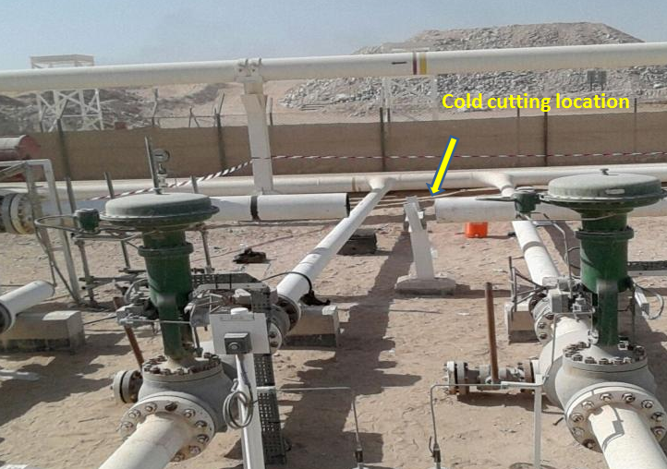
2
Contractor operator cuts through pressurised gas line
Why do we think it may have happened?
Five Class A permits were issued to the contractor on 4th March between 7:30 am and 10:30am, each permit contained more than one tie-in, in total around 51 tie-ins were grouped into five permits. Isolation certificates were not issued with the permits.
The Permit Holder had completed his allocated work ahead of the schedule, the Lead Piping Manager instructed him to start the cold cutting for Tie in 552B, assuming that all the tie-in locations were already fully isolated and safe to work. This assumption was shared by most contractor personnel.
The job was executed without the Permit Holder amending & validating his permit.
The pressure gauge on the line was not checked prior to commencing cutting the line.

Slide 10
3
Contractor cold cuts line during cleaning operations
Learning from Incidents
For PDO staff and contractors
A contractor was engaged in cleaning operations when the Permit Holder decided to cold cut a redundant line (not mentioned in the PTW) however, the crew placed the cutter on the wrong line causing damage to the line.
(29th March 2015)

Slide 11
3
Contractor cold cuts line during cleaning operations
What happened :
At about 1415 Hrs, Mechanical crew were engaged in site cleaning activity (shifting and removal of cut pipes). During the process the Permit Holder decided to cold cut the redundant MM265 line (which was not mentioned in the permit) however, the crew placed the cold-cutting device on the live oil flowline MM264 which was running parallel to MM265. The crew stopped the activity after seeing drops of oil coming out from MM264.

Slide 12
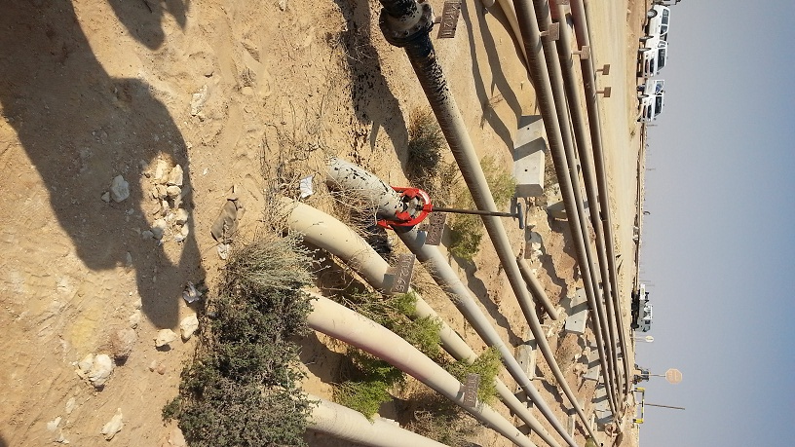
3
Contractor cold cuts line during cleaning operations
Why do we think it may have happened?
The crew could not distinguish between the lines (the redundant and live line).
The permit holder did not confirm that the crew has placed the cutter on the required line prior to cutting.
The job was executed without the Permit Holder amending & validating his permit.
MM264
MM265

Slide 13
Intervene
Safety day video clip: Intervene
http://pdointernet/hseforcontractors/SafetyDay2015/Safety%20Day%202015.mp4

Slide 14
Discussion Points
Discussion:
How do you ensure you are cutting the correct flowline/pipeline?
How do you know if the line is live or not?
What are the topics to be discussed in the Toolbox Talk before cold-cutting activity takes place?
How do you find out the correct steps for the cold-cutting activity?
Do you have a valid permit to work/authorization to start cold-cutting activity?
Are the flowlines to be worked on marked clearly and correctly?
How do you supervise the cold-cutting task?
Are you familiar with the cold-cutting procedures PR-1146 & PR-1991?

