Slide 1
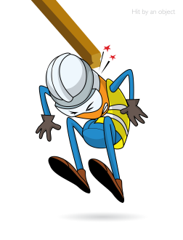
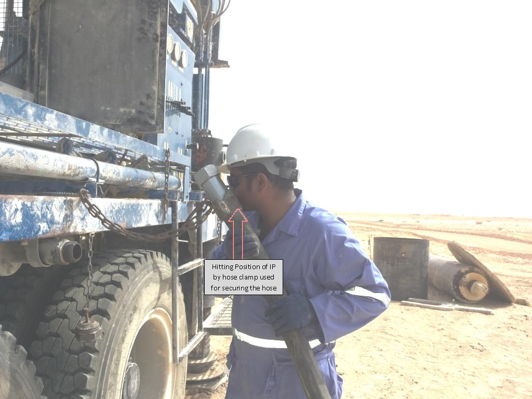
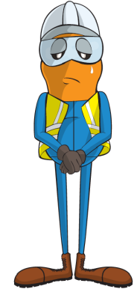
PDO Incident First Alert
Incident type | LTI(#17) | PIM ID | 1089318
Date/ time | 21/04/2015 (09:25 hrs) | Directorate
Location | Rabab – Harweel Area | Dept
What happened
A contractor was de-coupling a flexible hose in preparation for a rig move when the residual pressure in the hose caused it to whip up and hit him in the face causing a fracture to his jaw.
Mr. Musleh asks the questions of can it happen to you?
Do you ensure pressurised equipment is depressurised before breaking connections?
How do you ensure they are depressurised?
Do you ensure you stay out of the line of fire of anything that can hurt you?
Please disseminate this LTI notification to your teams and use it in your tool box talks and HSE meetings and notice boards.

