Slide 1
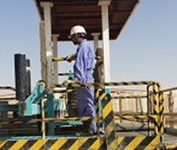
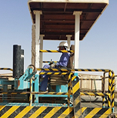
PDO Safety Advice
Use this Advice: Discuss in Tool Box Talks and HSE Meetings ➔ Distribute to contractors ➔ Post on HSE Notice Boards ➔ Include in site HSE Induction
Outside of protection zone
Date: 09/03/2015
Injury: Head injury
What happened?
During the deployment of hoses, the operator should have been sitting in safety zone wearing a seat belt but due to defective equipment was standing on the back of a moving vehicle when he lost his balance and fell backwards hitting his head on the post of a safety barrier. The impact resulted in a fatal head injury.
Your learning from this incident...
Never use defective equipment.
Never stand on a moving vehicle.
Always ensure maintenance requests are recorded and followed up.
Do not be afraid to exercise ’Stop’
In seat with seat belt fastened
Ensure safety devices are working prior to starting work
Contact MSE34 for further information Learning No 12 09/03/2015

Slide 2
Management learning's
Distribute to contractors ➔ Post on HSE Notice Boards
Date: 09/03/2015
Injury: Head injury
As a learning from this incident and ensuring continual improvement, all contract
managers are to review their HSE HEMP against the questions asked below .
Confirm the following:
Is adequate risk assessment done for all work equipment?
Do you monitor and ensure your staff conduct daily equipment inspections?
Do you have an adequate defect reporting systems in place?
Do you have adequate Safe Working Procedures in place for all activities?
Do you ensure employees comply with the procedures and safety guidance?
Learning No 12 09/03/2015

