Slide 1
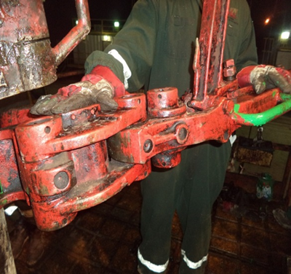
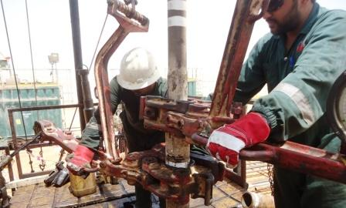
PDO Safety Advice
Use this Advice: Discuss in Tool Box Talks and HSE Meetings ➔ Distribute to contractors ➔ Post on HSE Notice Boards
Date: 16/04/2015
LTI: Ring finger injury
What happened
While break out of lifting sub operation with manual tongs was in progress and when driller picked up the make-up tong with sand line, the Roustabout’s right hand trapped in between the manual tong and elevator (Pinch point).
Learnings from this incident..
Always carry out competence assessment for new employee before placing in different job.
Implement MOC for any change.
Use right tool/equipment for right job.
Report any incident immediately for whatever the severity.
All the manual & powered equipment are color coded.
Identify the pinch points.
Always Intervene for any unsafe act/condition.
Hands off crush points
Contact MSE34 for further information Learning No 20 16/04/2015

Slide 2
Management learning's
Distribute to contractors ➔ Post on HSE Notice Boards
Date: 16/04/2015
LTI: Ring finger injury
As a learning from this incident and ensure continual improvement all contract
managers are to review their HSE HEMP against the questions asked below
Confirm the following:
Have you ensured the right people assigned for right job?
Right equipment used for right job?
Have your equipment been color coded for identifying pinch points?
Do you encourage your employees to exercise “Empowerment to STOP Unsafe Work”?
Learning No 20 16/04/2015

