Slide 1
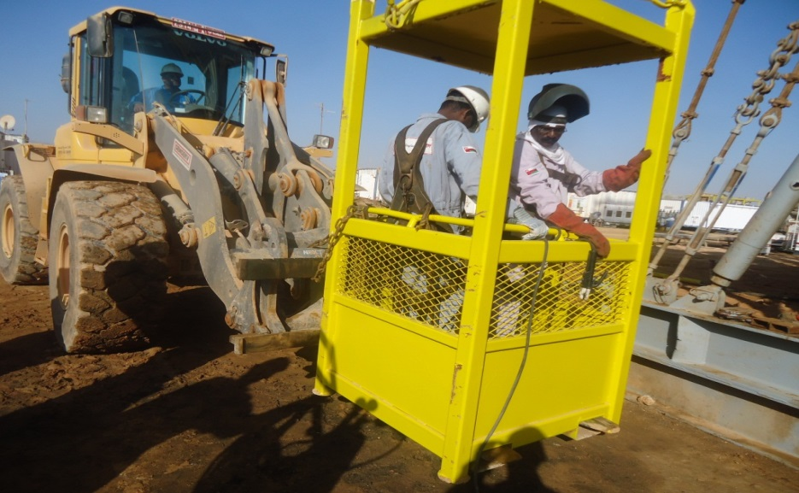
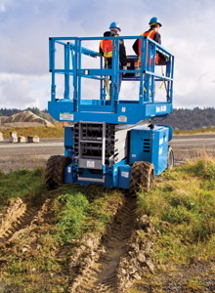
PDO Safety Advice
Use this Advice: Discuss in Tool Box Talks and HSE Meetings ➔ Distribute to contractors ➔ Post on HSE Notice Boards
Date: 30/03/2015
HIPO: Man Riding Basket Incident
What happened
A Welder & Fabricator were being lifted to their working area in a man riding basket by wheel loader with fork attachment. The wheel loader operator was watching the activity by keeping the forks parallel to the ground. While the activity was ongoing for 1 hr and 45 min., the man riding basket slid off the forks, resulting in a fall from a height of 2.68m to the ground. The welder landed outside of the basket while the fabricator remained inside. Both people sustained minor injuries.
Learnings from this incident..
Use equipment only for its intended purpose, and within its design limits
Only OEM approved equipment to be used
Follow PR 1708, item 4.5 for Personnel Lifting, use of fork lift for personnel lifting is only allowed if supported by risk reduction measures to ALARP level, the ALARP demonstration must be approved by the authorised subject matter expert for lifting and hoisting.
Use equipment only for its intended use
Contact MSE34 for further information Learning No 17 30/03/2015

Slide 2
Management learning's
Distribute to contractors ➔ Post on HSE Notice Boards
Date: 30/03/2015
HIPO: Man Riding Basket Incident
As a learning from this incident and ensure continual improvement all contract
managers are to review their HSE HEMP against the questions asked below
Confirm the following:
PDO regulation on “safe use of man riding basket” clearly spells out do’s/ don’ts; Is it understood by us?
2. In our operation are we using Man Riding basket correctly?
Are we using Fork lift / other mobile equipment to lift personnel using Man Basket
arrangements or similar?
Learning No 17 30/03/2015

