Slide 1
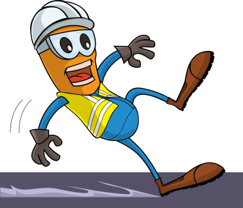
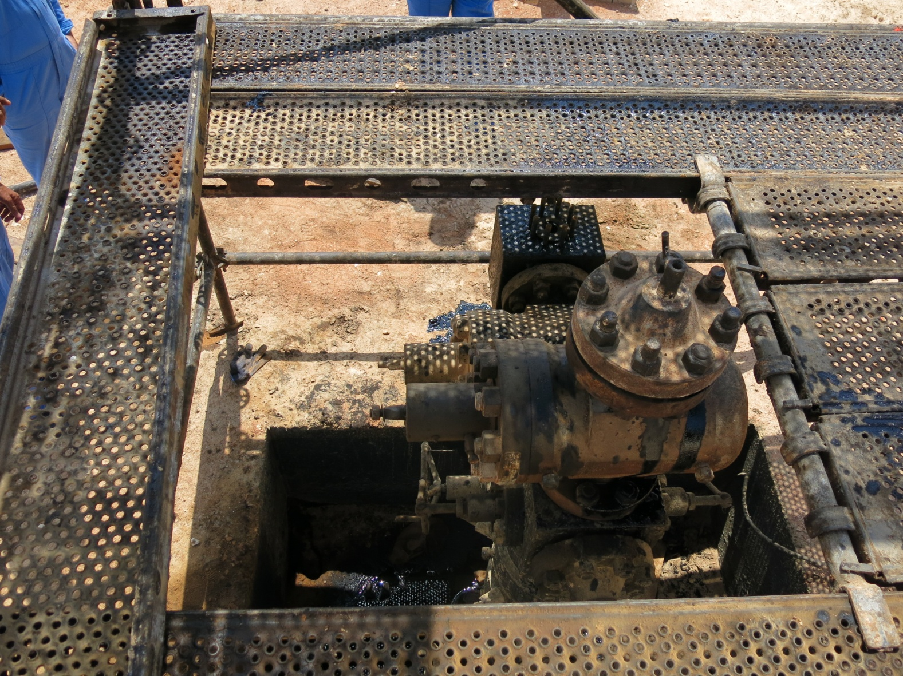
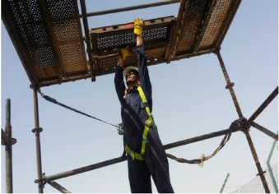
PDO Safety Advice
Use this Advice: Discuss in Tool Box Talks and HSE Meetings ➔ Distribute to contractors ➔ Post on HSE Notice Boards
Date: 23/05/2015
LTI: Fractured Hand
What happened?
Technician was rigging down the wellhead platform at Amal, which had 2 levels (1st level at 1.5 m from Ground and 2nd level at 2m from the first), while trying to remove the second level small planks with hammer and his hands, his foot slipped from the platform and he fell onto the Well Head. His right arm hit the Well Head cap resulting in a fracture.
Your learning from this incident..
Always ensure the safety harness remains hooked up until the job completed.
Include Slip Hazards in the TBT.
Ensure open areas have barriers to prevent falls.
Hook up your harness when working at height
Contact MSE34 for further information Learning No 26 23/05/2015

Slide 2
Management learning's
Distribute to contractors ➔ Post on HSE Notice Boards
Date: 23/05/2015
LTI: Fractured Hand
As a learning from this incident and ensure continual improvement all contract
managers are to review their HSE HEMP against the questions asked below
Confirm the following:
Was there TBT in place?
Are openings in structured cordoned off to prevent falls?
Are safety harnesses worn and hooked up during the task?
Are the roles and responsibilities clear to the parties involved?
Learning No 26 23/05/2015

