Slide 1
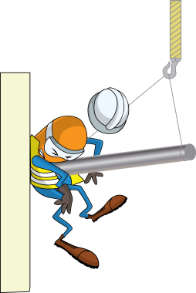
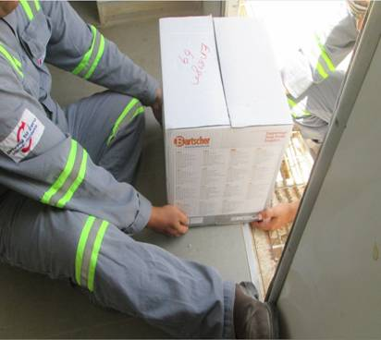
PDO Incident First Alert
Incident type | LTI (#34) | PIM ID | 1090625
Date/ time | 19/08/2015 (14:40 hrs) | Directorate
Location | Rig#60 Qarn Alam | Dept
Heavy Safe
What happened
An electrician and his colleague were transferring a heavy safe to the camp radio cabin. On reaching the radio room front door he turned and walked backwards up the steps into the cabin. As his colleague began to climb the steps the electrician lost his balance and fell over inside the cabin with the safe landing on his left hand crushing his ring finger.
Electrician walking backward and fell
Mr. Musleh asks the questions of can it happen to you?
Do you plan your route before carrying heavy loads?
Do you make sure you are capable of lifting the load beforehand?
How do you coordinate with someone else helping you carry the load?
How do you plan to climb steps when carrying a heavy load with someone?
Please disseminate this LTI notification to your teams and use it in your tool box talks and HSE meetings and notice boards.

