Slide 1
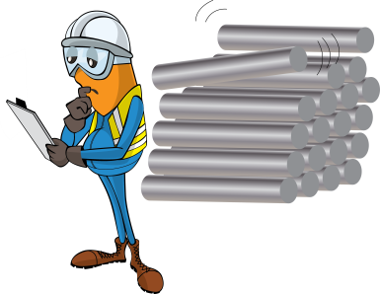
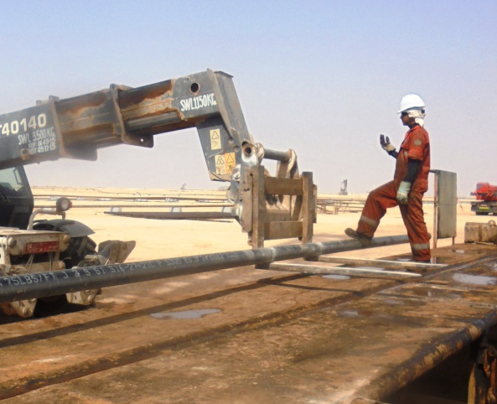
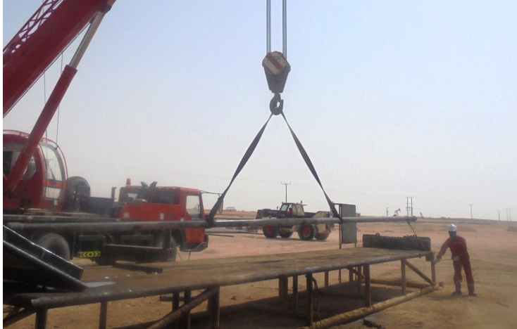
PDO Safety Advice
Use this Advice: Discuss in Tool Box Talks and HSE Meetings ➔ Distribute to contractors ➔ Post on HSE Notice Boards
Date: 22/06/2015
LTI: Fractured foot
What happened?
The Roustabout wanted to pick up a unbalanced load without using the webbing slings. The Forklift Operator objected, but the Roustabout insisted. The Roustabout used his foot to adjust the pipe balanced on the fork of a forklift resulting in the pipe falling and hitting his foot.
Your learning from this incident..
Always use the correct lifting method
Stay out of the line of fire
Use tag lines
Listen to your colleagues if the they tell you its unsafe
Always ensure you are away from suspended loads
Contact MSE34 for further information Learning No 29 22/06/2015

Slide 2
Management learning's
Distribute to contractors ➔ Post on HSE Notice Boards
Date: 22/06/2015
LTI: Fractured foot
As a learning from this incident and ensure continual improvement all contract
managers are to review their HSE HEMP against the questions asked below
Confirm the following:
Are your operating procedure clear and understood?
Are your personnel trained in SOP’s?
Are staff aware of their empowerment to stop unsafe acts?
Learning No 29 22/06/2015

