Slide 1
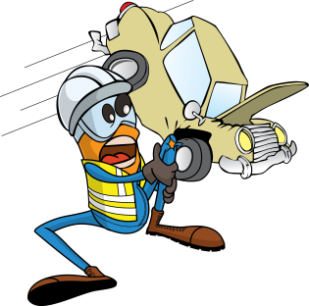
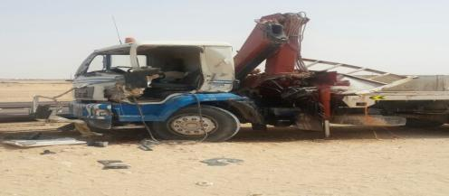
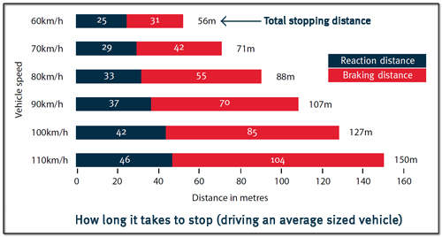
PDO Safety Advice
Use this Advice: Discuss in Tool Box Talks and HSE Meetings ➔ Distribute to contractors ➔ Post on HSE Notice Boards
Date:10.06.2015
LTI: Broken Arm
What happened?
During a recent vehicle journey, a Hiab was involved in an incident where the vehicle ran into the rear of another vehicle. The driver did not keep enough distance between him and the vehicle in front. The driver sustained a broken arm but the injuries could have been far more severe.
Your learning from this incident.
Always leave sufficient distance between yourself and any vehicle in front.
Adjust your distance based on the road conditions. It will take longer to stop on a graded road so you should increase the distance.
Take regular breaks and stay alert!
Keep a safe distance and expect the unexpected
Contact MSE34 for further information Learning No 34 10/06/2015

Slide 2
Management learning's
Distribute to contractors ➔ Post on HSE Notice Boards
Date:10.06.2015
LTI: Broken Arm
As a learning from this incident and ensure continual improvement all contract
managers are to review their HSE HEMP against the questions asked below
Confirm the following:
Has a recent TBT discussed Defensive Driving Techniques (especially for graded roads)?
Have Risk Assessments been updated / reviewed after the last incident within your company?
Have your drivers been assessed recently?
Contact MSE34 for further information Learning No 34 10/06/2015

