Slide 1
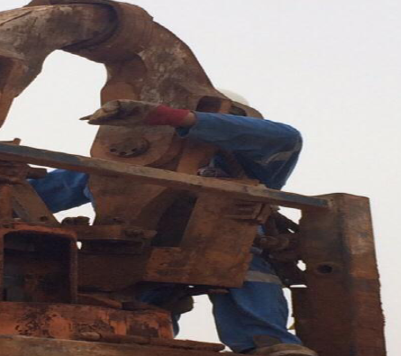
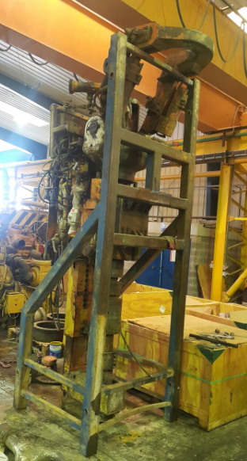
PDO Safety Advice
Use this Advice: Discuss in Tool Box Talks and HSE Meetings ➔ Distribute to contractors ➔ Post on HSE Notice Boards
Date: 11.06.2015
LTI: Fractured arm
What happened?
The engineer was repairing the Top Drive System (TDS). To do so, the crane was hooked on to the TDS swivel and lifting attempts were made to disconnect the quill from the drive gear without success due to some obstructions. At this time the TDS engineer went up on the stand to see the obstruction and he disconnected the crane hook from the swivel, leaving the swivel link in the vertical position. Whilst inspecting the point of obstruction, the swivel tilted to the horizontal position trapping the engineers left arm between the swivel link and the TDS stand resulting in a fracture hand.
Your learning from this incident:
Always ensure SOP / work instructions are followed
Ensure all non-routine activities are performed under PTW with adequate supervision
Never put you body parts in potential crush points
Always ensure equipment are in resting position prior to working on them.
Never place your body parts in crush points
Contact MSE34 for further information Learning No 35 11/06/2015

Slide 2
Management learning's
Distribute to contractors ➔ Post on HSE Notice Boards
Date: 11.06.2015
LTI: Fractured arm
As a learning from this incident and ensure continual improvement all contract
managers are to review their HSE HEMP against the questions asked below
Confirm the following:
Does your standards/ procedures address the handling of TDS swivel?
Is there is clear method of communication during operations on Rig floor?
Are hazards identified?
Do you have system in place to ensure that all the crew have attended the TBT,JSA/SOP discussion?
Contact MSE34 for further information Learning No 35 11/06/2015

