Slide 1
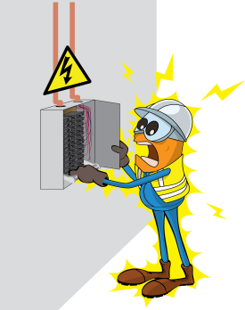
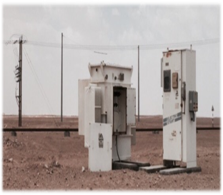
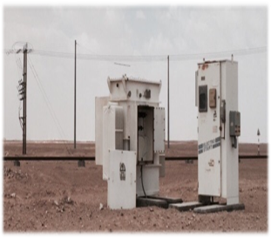
PDO Safety Advice
Use this Advice: Discuss in Tool Box Talks and HSE Meetings ➔ Distribute to contractors ➔ Post on HSE Notice Boards
Date: 13/06/2015
LTI: Electrical burns
What happened?
Two Commissioning Engineers unintentionally approached the secondary side of the step down transformer and disconnected a live cable. As a result, an Arc Flash occurred causing external burn injuries to one of them.
Your learning from this incident..
Always use the pre-electrical safety checklist
Always conduct a Job Hazard Analysis (JHA) prior to starting any electrical task.
Always adhere to Electrical Safety rules.
Always use the correct tools
Always check isolations before working on equipment
Only conduct work that you are competent to conduct
Always ensure isolation before performing any maintenance on Electrical equipment’s
Contact MSE34 for further information Learning No 38 13/06/2015

Slide 2
Management learning's
Distribute to contractors ➔ Post on HSE Notice Boards
Date: 13/06/2015
LTI: Electrical burns
As a learning from this incident and ensure continual improvement all contract
managers are to review their HSE HEMP against the questions asked below
Confirm the following:
Do you ensure that risk assessments are conducted prior to each task?
Are you evaluating the competency of field employees practically?
Do you have suitable and sufficient procedures for safety critical tasks?
Are the company procedures monitored and updated?
Contact MSE34 for further information Learning No 38 13/06/2015

