Slide 1
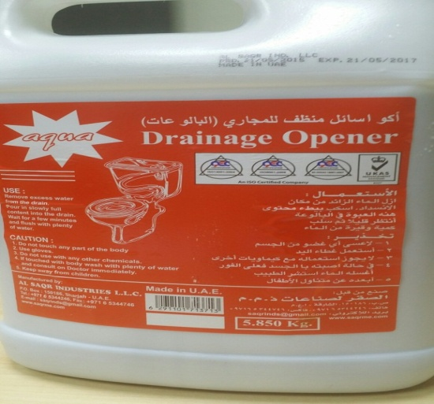
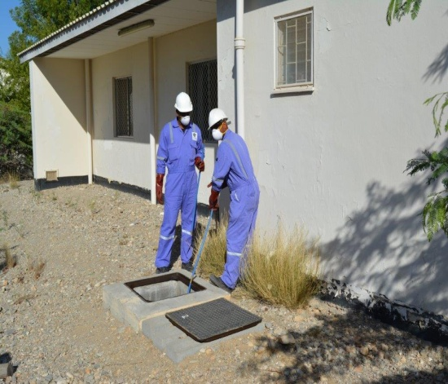
PDO Safety Advice
Use this Advice: Discuss in Tool Box Talks and HSE Meetings ➔ Distribute to contractors ➔ Post on HSE Notice Boards
Date: 22/08/2015
Injury: Chemical burns
What happened?
An operator suffered chemical burns to hand whilst using a chemical based drain clearing fluid. He was not trained in the use of chemicals and was not provided with the necessary PPE. There was no valid MSDS available and no risk assessment undertaken on the product.
Your learning from this incident…
Chemical drain clearing fluids should not be used under any circumstances.
Blocked drains should be cleared by rodding or other mechanical means.
Chemicals should be eliminated/substituted whenever reasonably practicable.
Ensure you have an MSDS for all chemicals and ensure that a suitable and sufficient risk assessment is undertaken.
Always wear the correct PPE when dealing with chemicals.
Understand your chemicals, eliminate where possible, assess and train.
Contact MSE34 for further information Learning No 45 22/08/2015

Slide 2
Management learning's
Distribute to contractors ➔ Post on HSE Notice Boards
Date: 22/08/2015
Injury: Chemical burns
As a learning from this incident and to ensure continual improvement all
contract managers are to review their HSE HEMP against the questions
asked below:
Confirm the following:
Have the arrangements for the management of chemicals been reviewed and revised as necessary?
Have they been eliminated or substituted so far as is reasonably practicable?
Have the associated processes been reviewed and revised as necessary?
Have arrangements been reviewed to modify behaviors?
Have the arrangement for monitoring work been improved?
Contact MSE34 for further information Learning No 45 22/08/2015

