Slide 1
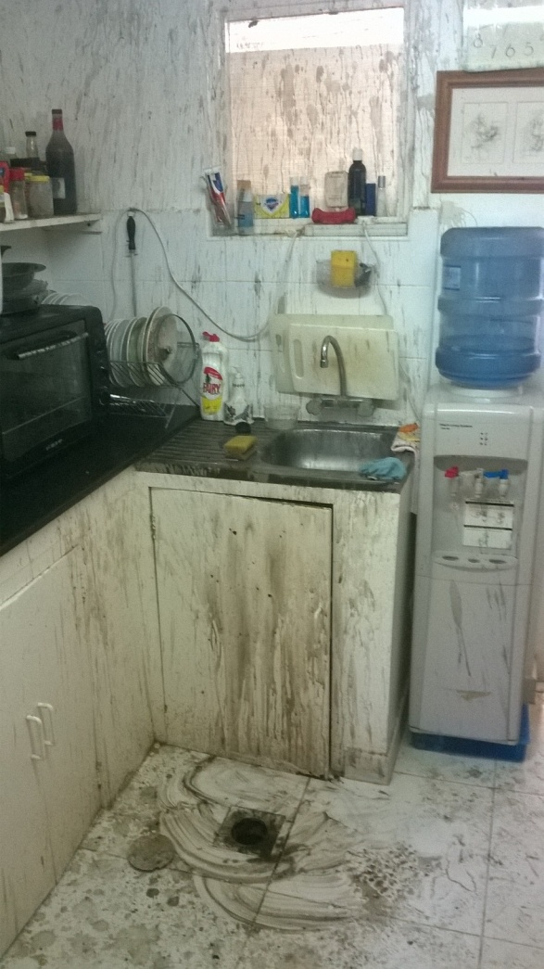
PDO Safety Advice
Use this Advice: Discuss in Tool Box Talks and HSE Meetings ➔ Distribute to contractors ➔ Post on HSE Notice Boards
Date: 15/09/2015
Injury: Chemical burns
What happened?
A violent chemical reaction with an unknown substance occurred when an Alkali based drain cleaner (Caustic Soda) was used to clear a blockage.
Your learning from this incident…
Chemical drain clearing fluids should not be used under any circumstances.
Blocked drains should be cleared by rodding or other mechanical means.
Chemicals should be eliminated/substituted whenever reasonably practicable.
Ensure you have an MSDS for all chemicals and ensure that a suitable and sufficient risk assessment is undertaken.
Always wear the correct PPE when dealing with chemicals.
Ensure that appropriate training is provided.
Photo explaining what was donewrong
Photo explaining how it should be done right
Do not use chemicals if you do not know the hazards.
Contact MSE34 for further information Learning No 44 15/09/2015

Slide 2
Management learning's
Distribute to contractors ➔ Post on HSE Notice Boards
Date: 15/09/2015
Injury: Chemical burns
As a learning from this incident and to ensure continual improvement all
contract managers are to review their HSE HEMP against the questions
asked below:
Confirm the following:
Have the arrangements for the management of chemicals been reviewed and revised as necessary?
Have the arrangements been eliminated or substituted so far as is reasonably practicable?
Have the associated processes been reviewed and revised as necessary?
Have arrangements been reviewed to modify behaviors?
Have the arrangement for supervision and monitoring work been improved?
Contact MSE34 for further information Learning No 44 15/09/2015

