Slide 1
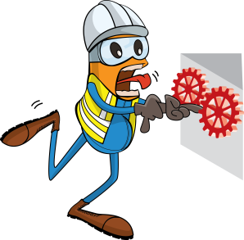
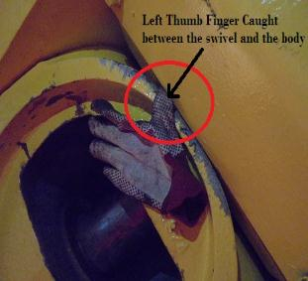
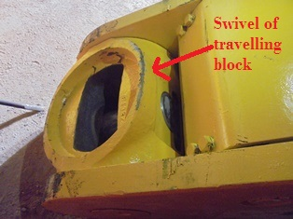
PDO Safety Advice
Use this Advice: Discuss in Tool Box Talks and HSE Meetings ➔ Distribute to contractors ➔ Post on HSE Notice Boards
Date:11.11.2015
LTI: Amputated thumb
What happened?
A crane was rigging a new traveling block up to the rig floor. The driller – thinking the travelling block swivel was stuck – tried to free it by hand and as it came free it rotated trapping his thumb against the body of traveling block resulting in the amputation of his thumb.
Your learning from this incident:
Ensure if a supervisor is directly involved in the task that another person is appointed to ensure adequate supervision.
Ensure hands and fingers are clear of moving/rotating parts
Ensure newly identified hazards are risk assessed and controls put in place.
Always consider hands off work methodology.
Stay out of the “Line of Fire”
Keep your hands & fingers away from potential pinch points
Contact MSE34 for further information Learning No 54 11/11/2015

Slide 2
Management learning's
Distribute to contractors ➔ Post on HSE Notice Boards
Date:11.11.2015
LTI: Amputated thumb.
As a learning from this incident and to ensure continual improvement all contract managers are to review their HSE HEMP against the questions asked below:
Confirm the following:
Do you have an effective program to address hands & fingers related risks?
Do you have an effective system to manage change?
Do your supervisors ensure they set a good example and supervise effectively?
Do your supervisors ensure that another supervisor is appointed if they are directly involved in a task?
Contact MSE34 for further information Learning No 54 11/11/2015

