Slide 1
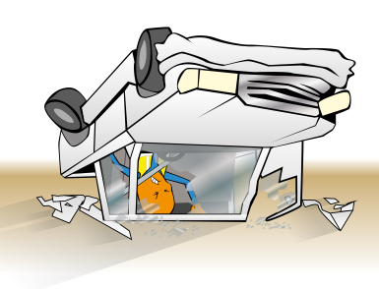
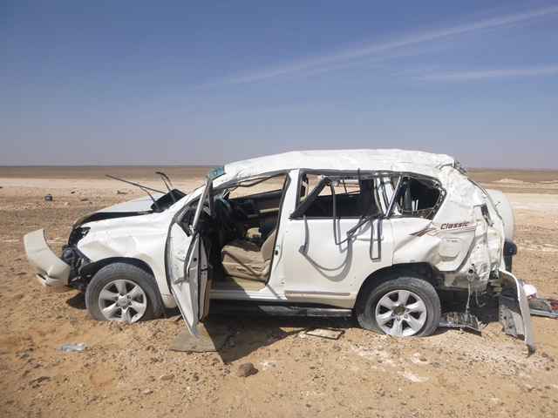
PDO Safety Advice
Use this Advice: Discuss in Tool Box Talks and HSE Meetings ➔ Distribute to contractors ➔ Post on HSE Notice Boards
Date:10.11.2015
LTI: Multiple fractures
What happened?
A drilling superintendant was driving from Rig 43 to Nizwa. Whilst approaching a right hand bend on a graded road he lost control of the vehicle resulting in the vehicle rolling over several times. The driver suffered a crush injury to his left hand which resulted in multiple fractures.
Your learning from this incident:
Ensure you have the correct license and valid defensive driving permit.
Ensure the journey management plan is followed.
Ensure you communicate with the journey manager if a change has to be made while en-route.
Always follow the Safe Journey Management Plan
Contact MSE34 for further information Learning No 55 10/11/2015

Slide 2
Management learning's
Distribute to contractors ➔ Post on HSE Notice Boards
Date:10.11.2015
LTI: Multiple fractures
As a learning from this incident and to ensure continual improvement all contract managers are to review their HSE HEMP against the questions asked below:
Confirm the following:
Are all company vehicles included in your IVMS management system?
Do you monitor compliance of routes used by IVMS tracking?
Does your management system ensure defensive driving permits are valid?
Do you advise drivers which roads are authorised and which are unauthorised?
Contact MSE34 for further information Learning No 55 10/11/2015

