Slide 1
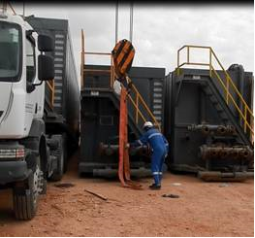
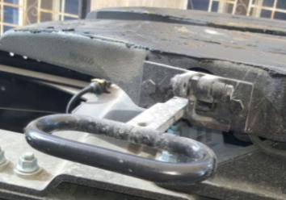
PDO Safety Advice
Use this Advice: Discuss in Tool Box Talks and HSE Meetings ➔ Distribute to contractors ➔ Post on HSE Notice Boards
Date: 17-11-2015
Injury:- Fatal crush
What happened?
The deceased unlocked the truck and tank fifth wheel connector on a truck to allow it to disconnect and pull forward from under a frac tank. The lock refused to stay open, so the driver held on to it as the truck drove out allowing a crane to support the tanks weight. But due to the cranes boom being in the wrong place the load swung sideward's and crushed the driver against another tank, killing him.
Your learning from this incident..
Never lift without a Person in Charge.
Never lift without a banksman.
Never lift with anyone in the lifting zone.
Refuse to use defective equipment.
Always think about being in the line of fire.
Never ignore the lifting rules
Contact MSE34 for further information Learning No 56 17/11/2015

Slide 2
Management learning's
Distribute to contractors ➔ Post on HSE Notice Boards
Date: 17-11-2015
Injury: Fatal crush
As a learning from this incident and to ensure continual improvement, all contract managers are to review their HSE HEMP against the questions asked below.
Confirm the following:
Do you ensure all lifting operations have a person in charge?
Do you perform lifting operations without a banksman?
Do you ensure your workers are fully aware of the job procedures?
Do your personnel understand that they can STOP?
Do you have a robust fault reporting process?
Do your systems manage your subcontractors effectively?
Are all supervisors aware of management of change processes
Do you manage changes effectively during rig up and rig down activities?
Do you know the locations of all assets at all times?
Contact MSE34 for further information Learning No 56 17/11/2015

