Slide 1
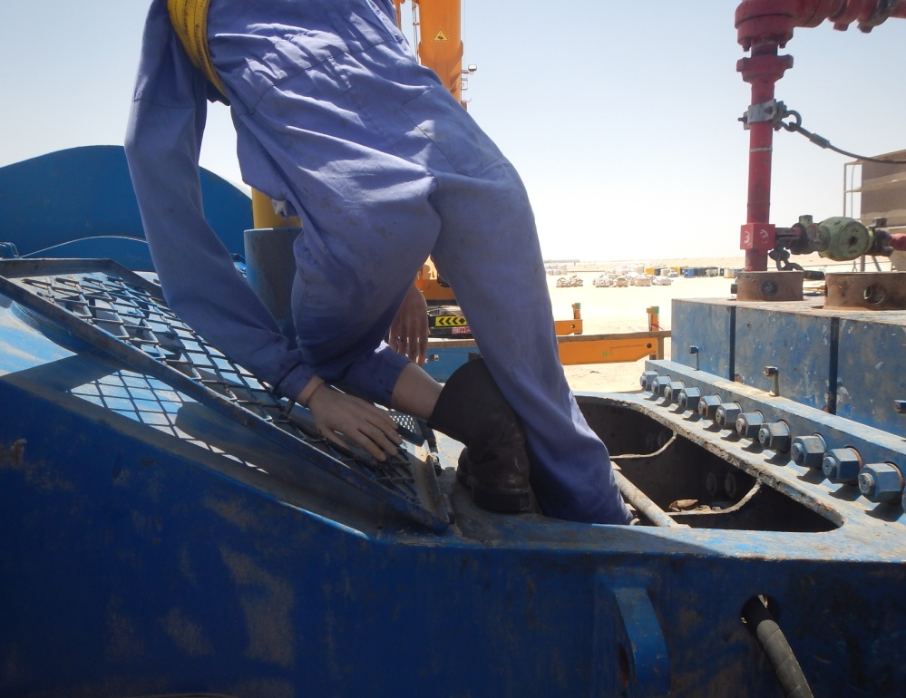
PDO Incident First Alert
Incident type | LTI (#13) | PIM ID | 1093319
Date/ time | 08/05/2016 (02:00 hrs) | Directorate
Location | Saih Rawl | Dept
What happened
A night tool pusher was standing on top of the mud pump cleaning with a wash gun while the pump was running and the piston cover was open; his right foot slipped inside the piston cavity causing a deep cut exposing the bone and resulting in multiple fractures to his ankle and foot.
Mr. Musleh asks the questions of can it happen to you?
Do you ensure that guards and covers are in place on machinery?
Do you ensure there is adequate lighting in the work area?
Are supervisors carrying out tasks instead of supervising?
Do you consider if you are ever in the ‘line of fire’?
Foot slipped into open cavity
Please disseminate this LTI notification to your teams and use it in your tool box talks and HSE meetings and notice boards.

