Slide 1
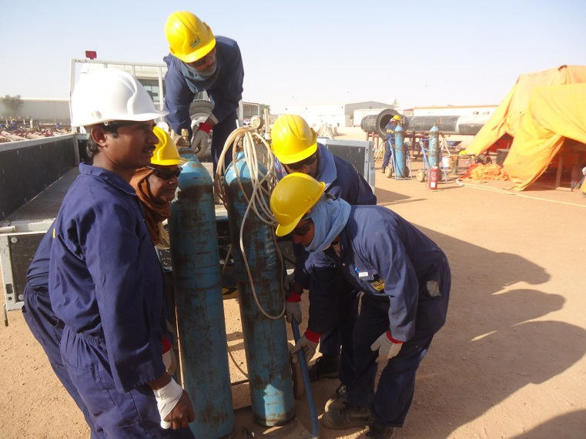
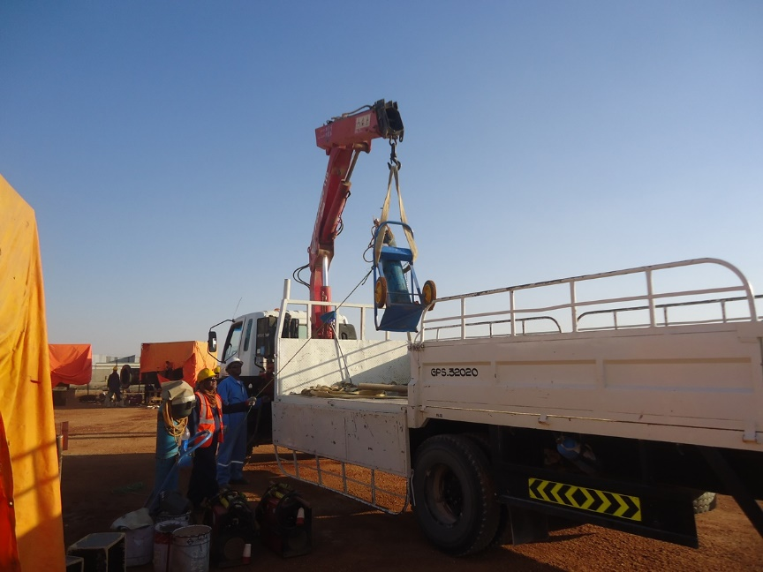
PDO Second Alert
Date: 03.01.16 LTI Bahja
What happened?
A four man team were unloading of a mobile cylinder trolley from a vehicle. As they placed it on the ground one of the team had his hand between the bottom of the trolley & the ground crushing his right hand little finger resulting in the tip being amputated.
Your learning from this incident..
Identify the hazards before starting the task
Never place your hands & fingers at pinch points
Use the correct lifting device for the task
Use empowerment to STOP unsafe acts
Use appropriate lifting devices while handling heavy loads

Slide 2
Management self audit
Date: 03.01.16 LTI Bahja
As a learning from this incident and to ensure continual improvement all contract managers are to review their HSE HEMP against the questions asked below
Confirm the following:
Do you have a lifting procedure in place?
Is there a system in place to monitor compliance with the lifting procedure?
Are all material handling activities properly planned & organized?
Are all those involved in material handling activities trained & competent?
Is material handling included in the HEMP?
Do you implement the TRIC effectively?

