Slide 1
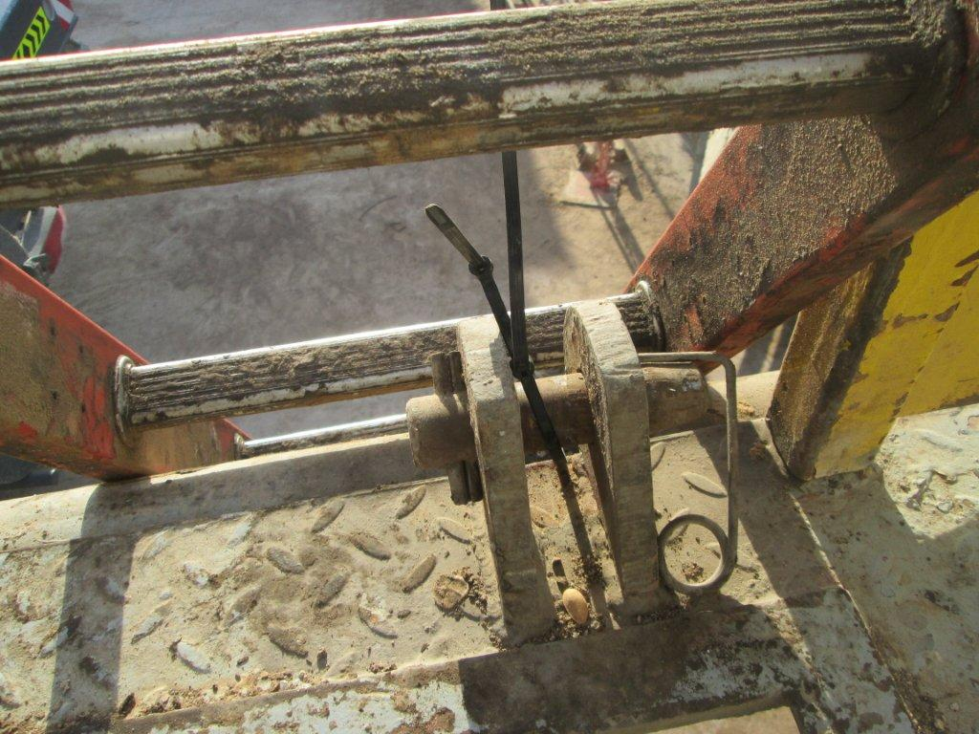
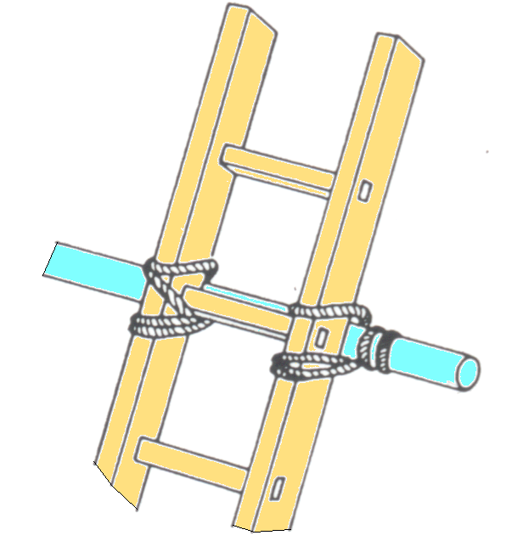
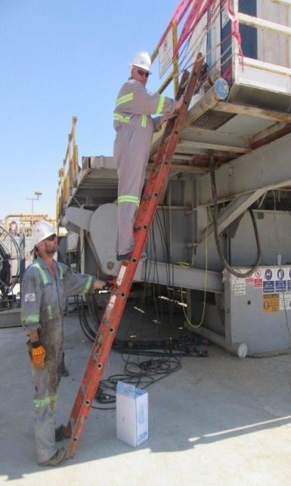
PDO Second Alert
Date: 13.02.16 LTI Rig 60
What happened?
An electrician was climbing a ladder secured at the top by electrical tie wraps to the lowered rig floor (rig move / rigging down), when the tie wrap snapped causing him to fall approximately 1.5 m (height from his foot on the ladder to the ground) resulting in a cut to the inside of his right ankle and a fractured heel requiring surgical intervention.
Your learning from this incident..
Ladders are to be used when complete (all sections together), properly secured and for short term use only.
Use of light weight tower scaffold, stairs or mobile elevating working platforms to be used for longer term jobs.
Ladder to be secured by either a person who remains footing the ladder or by correctly lashing the head / top of the ladder.
Photo explaining what was done wrong
Ensure your ladder is properly secured

Slide 2
Management self audit
Date: 13.02.16 LTI Rig 60
As a learning from this incident and to ensure continual improvement all contract managers must review their HSE HEMP against the questions asked below
Confirm the following:
Do you ensure safe egress/access to the rig floor during rig move operations?
Do you ensure your workforce are supplied with the right tools to work at height?
Do supervisors ensure the correct procedures are implemented and followed?
Do you have hazard hunts during rigging up and rigging down operations?
Do allow the use of split parts of extension ladders?
Notes:
Make a list of closed questions (only ‘yes’ or ‘no’ as an answer) to ask other contractors if they have the same issues based on the management or HSE-MS failings or shortfalls identified in the investigation. Pretend you have to audit other companies to see if they could have the same issues.

