Slide 1
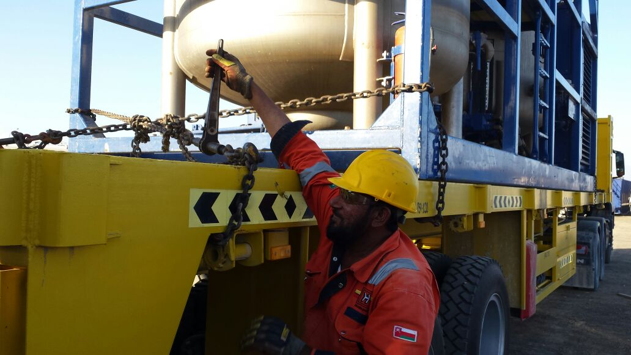
PDO Second Alert
Date: 24.02.16 LTI Saih Rawl
What happened?
A heavy vehicle contractor driver was unlatching chains and boomers from a batch mixer on top of a flatbed trailer (1.55 m high). The driver stepped to the side of the batch mixer pulling the chain in preparation to step down from the trailer. During this process he lost balance and fell on the ground injuring his left ankle and developing a calcaneus bone fracture.
Your learning from this incident..
Always ensure you are in a stable position while applying force (pulling a chain, tightening a bolt, etc) as energy can be released suddenly.
Ensure you attend the TBT / safety brief before starting work.
Supervisors to ensure that ONLY assigned & briefed personnel are involved in the task.
Do not participate in operations if you were not part of the TBT.
Always secure any loose items on equipment before transportation.
Always ensure a stable position when working at height!

Slide 2
Management self audit
Date: 24.02.16 LTI Saih Rawl
As a learning from this incident and to ensure continual improvement all contract managers must review their HSE HEMP against the questions asked below
Confirm the following:
1 Do you assess your contractors skills/understanding after conducting safety training?
2 Does your pre-departure checklist specifically mentions loose items / safety pins in place?
3 Does your HEMP have visual aids/photographs to be adequately/easily communicated to field population?
4 Does your supervisor training package include intervention in unsafe situations/acts?
Notes:
Make a list of closed questions (only ‘yes’ or ‘no’ as an answer) to ask other contractors if they have the same issues based on the management or HSE-MS failings or shortfalls identified in the investigation. Pretend you have to audit other companies to see if they could have the same issues.

