Slide 1
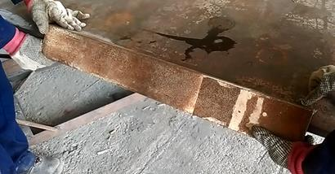
PDO Incident First Alert
Incident type | LTI (#27) | PIM ID | 1094743
Date/ time | 10.09.2016 at 16:00 hrs. | Directorate
Location | Workshop Yard Nimr | Dept
What happened
While welding a component to the gravel panel frame. The welder attempted to manually turn the panel over to weld the other side, the work piece slipped trapping his right hand underneath fracturing his thumb and little finger.
Mr. Musleh asks the questions of can it happen to you?
Do you ensure you keep your hands away from pinch points?
Do you consider if you are in the ‘line of fire’?
Do you ensure you are wearing the correct gloves for the task?
Pinch point
Please disseminate this LTI notification to your teams and use it in your tool box talks and HSE meetings and notice boards.

