Slide 1
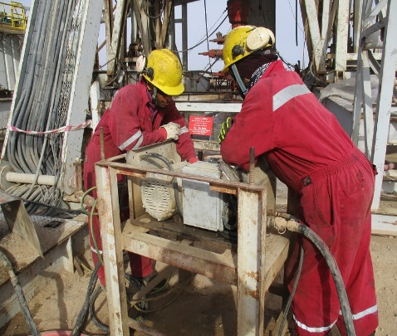
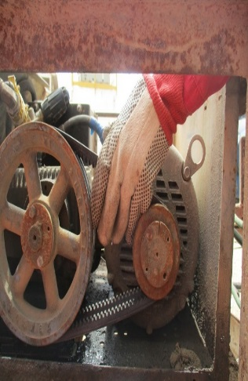
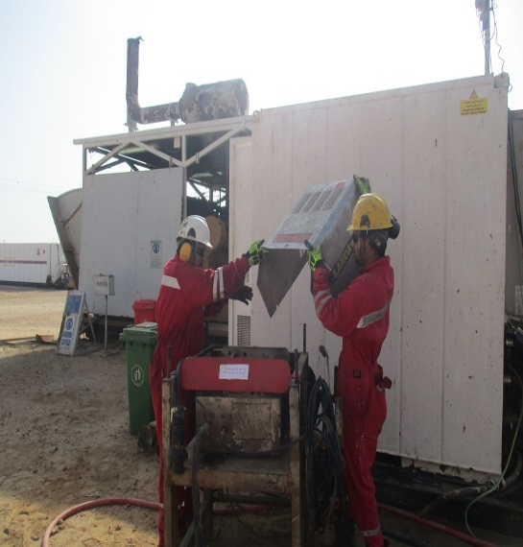
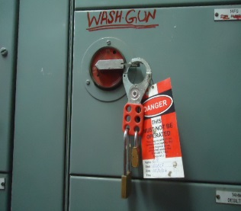
PDO Second Alert
Date: 05.04.16 LTI Rig 87
What happened?
An electrician and a mechanic were working on the wash gun unit. As the electrician was checking the machine’s rotary belt, the mechanic leaned against the side of the unit and his arm unintentionally pressed the “On” button. The rotary belt started to spin and pulled the electrician’s fingers into the pulley crushing the index and middle finger tips of his left hand.
Your learning from this incident..
Ensure equipment is adequately isolated before start of work.
Apply the 4 Golden Questions for Hands & Fingers safety.
Intervene and STOP all unsafe acts / conditions.
Communicate to the site supervisor (s) and obtain their guidance & approval, prior to the start of any repairs.
The cover removed without energy isolation and the electrician placed his hand between belt and wheel.
Isolated from SCR
Always comply to LSR, PTW & isolation
Repairs started after Energy isolation &
PTW in place

Slide 2
Management self audit
Date: 05.04.16 LTI Rig 87
As a learning from this incident and to ensure continual improvement, all contract managers must review their HSE HEMP against the questions asked below:
Confirm the following:
Do you have a system to verify effective implementation of PTW with LOTO?
Do you have a clear system on reporting failures (equipment/others)?
Do you ensure the above system (reporting failures) is effectively communicated to all staff?
Notes:
Make a list of closed questions (only ‘yes’ or ‘no’ as an answer) to ask other contractors if they have the same issues based on the management or HSE-MS failings or shortfalls identified in the investigation. Pretend you have to audit other companies to see if they could have the same issues.

