Slide 1
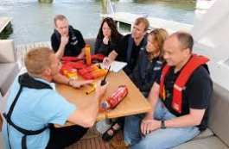
PDO Second Alert
Date: 04.04.16 LTI Bandar Al Khairan
What happened?
A PDO employee was on a team building “Away Day” in Bandar Al Kharian and as part of the day’s activities went on an inflatable banana boat ride on the sea. While the banana boat was being towed behind a speed boat, it rolled over and the people on it were thrown off into the sea. The employee was injured when his head hit the water and the glasses he was wearing were pushed into his face.
Your learning from this incident..
Identify hazards and carry out a formal HSE risk assessment before doing any social events or team building activities.
Do not wear any sharp / loose items while doing water sport activities.
Prior to selecting an event organizer, check their safety performance and that they can demonstrate good assessment of their risks and implementation of the required controls.
Ensure a safety briefing is given where appropriate

Slide 2
Management self audit
Date: 04.04.16 LTI Bandar Al Khairan
As a learning from this incident and to ensure continual improvement, all contract managers must review their HSE HEMP against the questions asked below:
Confirm the following:
Does your HEMP cover all activities including team / social events?
Do you check if there has been any previous incidents for the type of activity you are undertaking?
Do you ensure a safety brief or TBT is given before starting the activity?
Do you ensure it covers all associated hazards for the activity?
Notes:
Make a list of closed questions (only ‘yes’ or ‘no’ as an answer) to ask other contractors if they have the same issues based on the management or HSE-MS failings or shortfalls identified in the investigation. Pretend you have to audit other companies to see if they could have the same issues.

