Slide 1
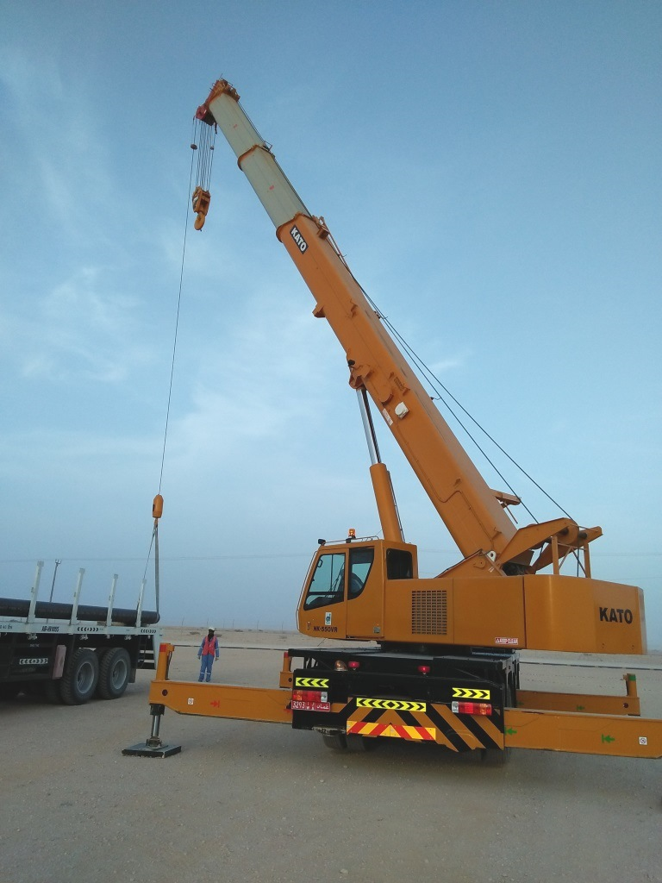
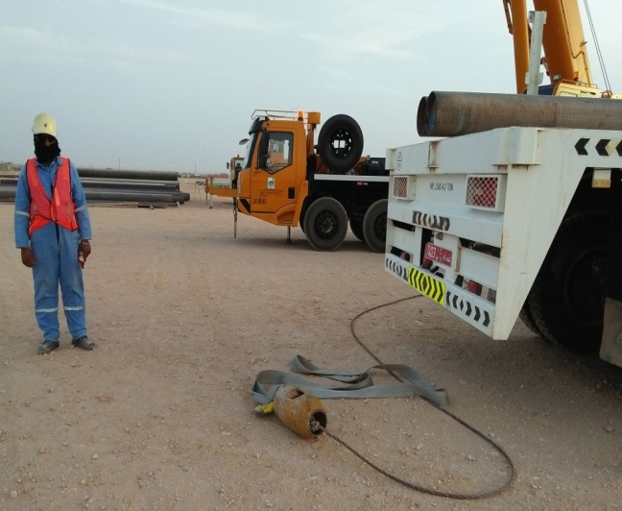
Safety Alert
Use this Alert: Discuss in Tool Box Talks and HSE Meetings ➔ Distribute to Contractors ➔ Post on HSE Notice Boards ➔ Include in Site HSE Induction
Lifting Equipment
While unloading 12” x 12 metre pipe from trailer using a 25-tonne crane, the auxiliary hook wire rope snapped and fell to the ground.
The hook, weighing 60kg landed 1.5m from the rigger who was at the rear of the trailer.
There was no 3rd party inspection on the auxiliary wire rope for the last 2 years.
2.8 Mtr Belt + 4.5 Mtr Rope = 7.3 Mtr Broken

Slide 2
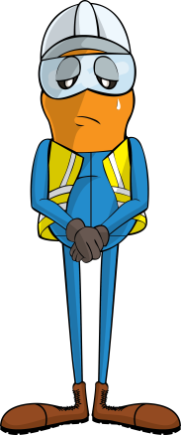
Safety Alert
Mr. Musleh asks the questions of can it happen to you?
Do you make sure the equipment being used has been tested and is fit for use?
Do you make sure the equipment and attachments are secure and valid 3rd party certificates are in date?
Do you ensure that the lift plan and the risk assessment are in place?
Do you ensure the work area is clear before carrying out lifting operations?

