Slide 1
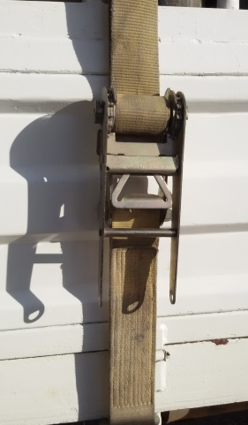
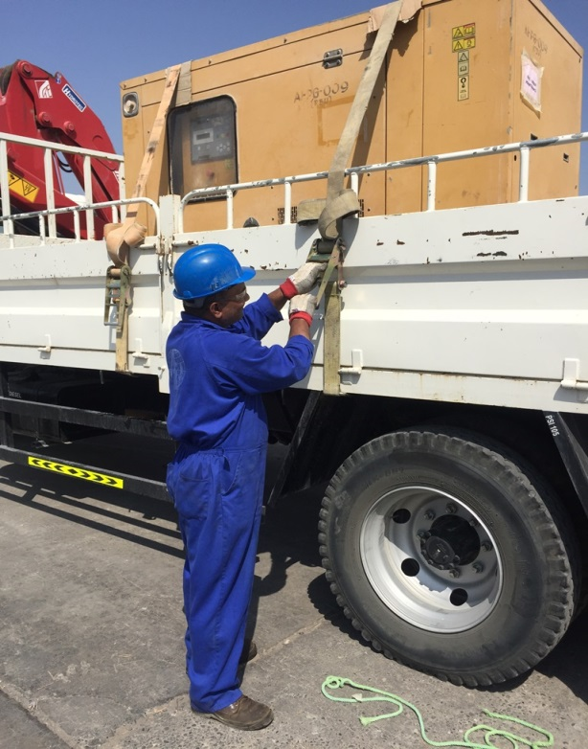
PDO Second Alert
Date: 28.09.16 Incident title: LTI Broken wrists
What happened?
A store assistant was securing a load on a Hiab truck with a belt and ratchet when the handle on the ratchet came out of its socket causing him to fall backwards landing on his hands and resulting fractures to both his wrists.
Your learning from this incident..
Task allocation shall be done in line with people’s qualifications and job responsibilities.
Equipment shall be checked and maintained by qualified personnel on the regular basis.
Employees shall ruse their right to stop and intervene if they are not qualified for it and if it is not part of their role.
Employees shall communicate their concerns to their supervisors and site management if they are given a job which is not part of their role.
Broken ratchet handle
Always keep your equipment maintained

Slide 2
Management self audit
Date: 28.09.16 Incident title: LTI Broken wrists
As a learning from this incident and to ensure continual improvement all contract managers must review their HSE HEMP against the questions asked below
Confirm the following:
Are all personnel trained for the tasks they are required to perform?
Are people assigned for the tasks correctly, based on their responsibilities and qualifications?
Is there is a clear line of communication between workforce and supervisors?
Are people empowered to say “No” to the jobs they are not qualified for?
Does site management fully support the empowerment to stop?
Do you ensure that regular inspections/ maintenance are implemented for load securing equipment?
Notes:
Make a list of closed questions (only ‘yes’ or ‘no’ as an answer) to ask other contractors if they have the same issues based on the management or HSE-MS failings or shortfalls identified in the investigation. Pretend you have to audit other companies to see if they could have the same issues.

