Slide 1
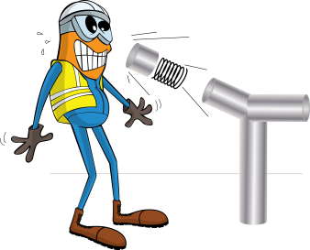
PDO Incident First Alert
Incident type | LTI (#10)
Date/ time | 03.01.2017 at 23:00 hrs. | Directorate
Location | Muscat | Dept
What happened
While trying to open the sampling bottle, the internal pressure released and a piece of metal from inside the bottle hit the engineers right hand resulting in a fracture to his right index finger. A window was also broken and fluid splashed over the wall and the floor.
Mr. Musleh asks the questions of can it happen to you?
Do you ensure you follow the correct disposal process?
Do you consider the risks of lone working?
Do you consider the release of stored energy?
Do you always consider if you are in the ‘line of fire’?
End cap and sampling bottle
Please disseminate this LTI notification to your teams and use it in your tool box talks and HSE meetings and notice boards.

