Slide 1
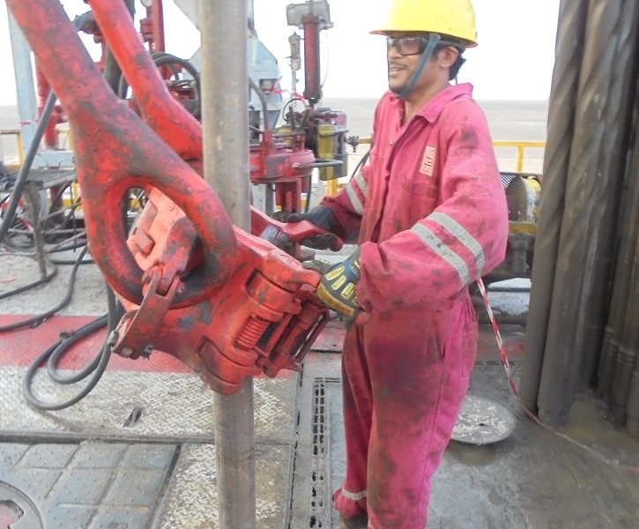
PDO Incident First Alert
Incident type | LTI (#14)
Date/ time | 03.05.2017 at 04:00 hrs. | Directorate
Location | Lekhwair/rig 49 | Dept
What happened
While running in the hole, the Floorman was latching the elevator to the casing joint in the mouse hole when his right hand middle finger got trapped between the joint and the elevator resulting in a crush injury to his right hand middle finger.
Mr. Musleh asks the questions of can it happen to you?
Do you always use the handles provided?
Do you ensure you keep your hands away of crush points?
Do you ensure you are away from “Line of Fire”?
Please disseminate this LTI notification to your teams and use it in your tool box talks and HSE meetings and notice boards.

