Slide 1
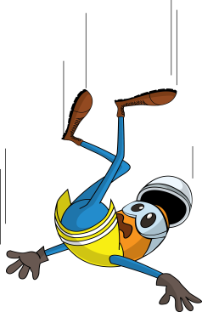
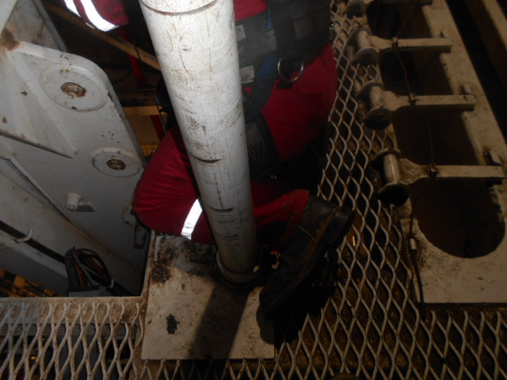
PDO Incident First Alert
Incident type | LTI (#21)
Date/ time | 17.06.2017 at 20:45 hrs. | Directorate
Location | Nimr | Dept
What happened
The Derrickman was standing on the monkey board platform close to the ladder as the Driller was lowering the Top Drive System (TDS). This resulted in his fall arrestor line getting caught on the TDS causing him to fall on the platform trapping his leg between the monkey board post and guide beam
Mr. Musleh asks the questions of can it happen to you?
Do you always ensure you are stood in safe zone?
Do you always check your surroundings for hazards?
Do you always ensure your fall arrestor is free from obstructions?
Do you coordinate activities with your work colleagues?
Please disseminate this LTI notification to your teams and use it in your tool box talks and HSE meetings and notice boards.

