Slide 1
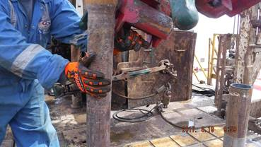
PDO Incident First Alert
Incident type | LTI (#30)
Date/ time | 18.08.2017 at 14:45 hrs. | Directorate
Location | Karim Small Field | Dept
What happened
A Floorman was moving a drill pipe into the elevator when he trapped his left hand between the pipe and elevator resulting in a fracture to his left hand ring finger.
Mr. Musleh asks the questions of can it happen to you?
Do you ensure you keep your hands and fingers away from pinch points?
Do you consider what could go wrong?
Do you ensure you are out of the “Line of fire”?
Pinch point
Please disseminate this LTI notification to your teams and use it in your tool box talks and HSE meetings and notice boards.

