Slide 1
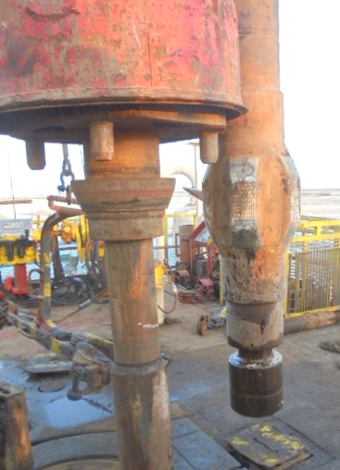
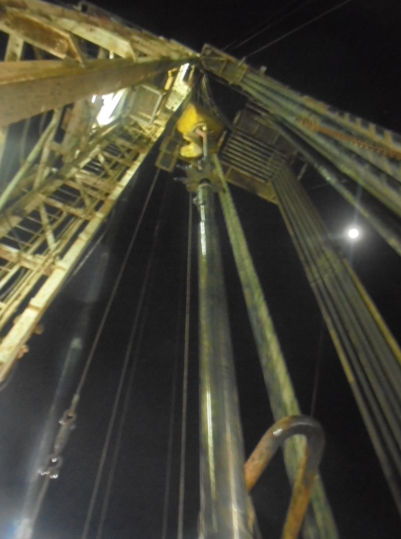
PDO Second Alert
Date: 26.05.2017 Incident title: LTI
What happened?
After installing rat hole scabbard the Kelly was rested on the rotary. 9-5/8” The crane operator picked up the motor to rotary table. While the 2 Floor men were guiding and pushing motor at rig floor, the crane boom got entangled with Kelly spinner causing Kelly assembly to move and swing towards the motor. As a result the Acting Floorman’s (Floorman-1) right hand ring finger got pinched between the Kelly Bushing Guard & the motor assembly. Floorman-2 received back pain, when he was pushed by the Kelly.
Your learning from this incident..
Always identify the hazards & dynamic risks during TBT
Make sure effective supervision is implemented during the task
Always discuss/implement 4 H & F golden Question to perform the task Hands free.
Maintain safe body position and stay away from line of fire,
No Go zone requirements are strictly implemented.
Ensure that there is no static / dynamic obstacles in the direction / area of the lift.
Finger pinched between the Kelly Bushing Guard and Motor assembly
Always stay out of the line of fire
Kelly is racked back while handling Motor with elevator.

Slide 2
Management self audit
Date: 26.5.17 Incident title: LTI
As a learning from this incident and ensure continual improvement all contract
managers must review their HSE HEMP against the questions asked below
Confirm the following:
Do you have JSA/ work instructions capturing the hazards and risks related to the dynamic pinch point?
Do you encourage your crew to intervene when ever an unsafe act/condition occurs?
Do your Supervisors ensure all hazards/ risks related to lifting operations are identified with the help of effective TBT with TRIC and Lift Plan?
Do you have an audit to monitor the safe lifting operations?
Notes:
Make a list of closed questions (only ‘yes’ or ‘no’ as an answer) to ask other contractors if they have the same issues based on the management or HSE-MS failings or shortfalls identified in the investigation. Pretend you have to audit other companies to see if they could have the same issues.

