Slide 1
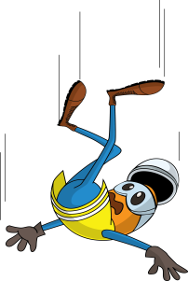
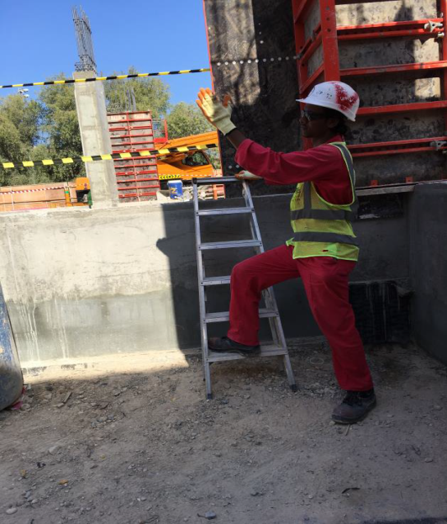
PDO Incident First Alert
Incident type | LTI (#41)
Date/ time | 04.11.17 at 16:10 hrs | Directorate | I
Location | Ras al Hamra | Dept
What happened
While a Scaffolder was guiding the scaffold team, he rested his right foot on a step ladder which slipped causing him to lose balance and fall resulting in a fracture to his left shoulder.
Mr. Musleh asks the questions of can it happen to you?
Do you use always pay attention to your footing?
Do you maintain good housekeeping at site
Do you always check your surroundings for hazards?
Reconstruction photo
Please disseminate this LTI notification to your teams and use it in your tool box talks and HSE meetings and notice boards.

