Slide 1
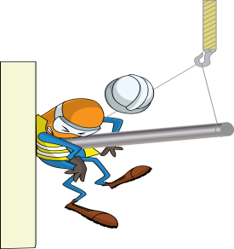
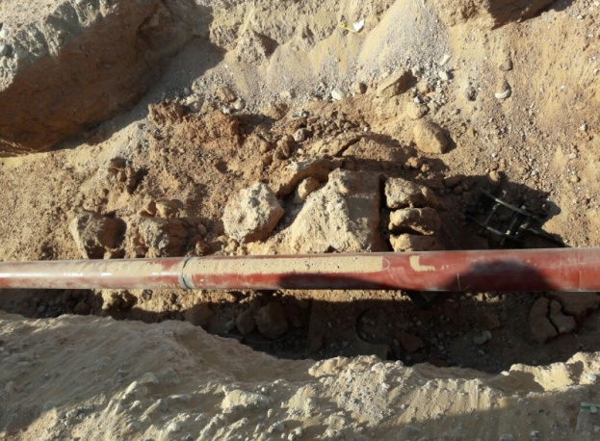
PDO Incident First Alert
Incident type | LTI (#42)
Date/ time | 06.05.17 at 15:00hrs | Directorate
Location | Yibal | Dept
What happened
While welding a pipe inside a trench, sand from the side wall collapsed moving the pipe, crushing the welder against the side wall of the trench, resulting in a fracture to his pelvis.
Mr. Musleh asks the questions of can it happen to you?
Do you ensure the trench sides are secured before entering an excavation?
Do you ensure all hazards are identified before performing the task?
Do you ensure adequate controls are in place?
Sand collapsed
Moved Pipe
Please disseminate this LTI notification to your teams and use it in your tool box talks and HSE meetings and notice boards.

