Slide 1
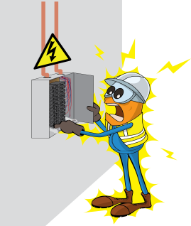
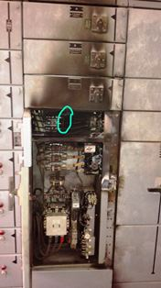
PDO Incident First Alert
Incident type | LTI (02)
Date/ time | 03.02.18 @16:30hrs | Directorate
Location | Marmul | Dept
What happened
While investigating a loss of power to a lighting circuit, an electrical flashover occurred when an electrician was tightening a loose cable on a fuse holder in a ‘live’ LV Panel, causing burns to his face and hands.
Mr. Musleh asks the questions of can it happen to you?
Do you ensure you have a valid Permit to Work (PTW) for the task?
Do you ensure the power is adequately isolated?
Do you always consider if you are in the ‘line of fire’?
Flashover point in live LV Panel
Please disseminate this LTI notification to your teams and use it in your tool box talks and HSE meetings and notice boards.

