Slide 1
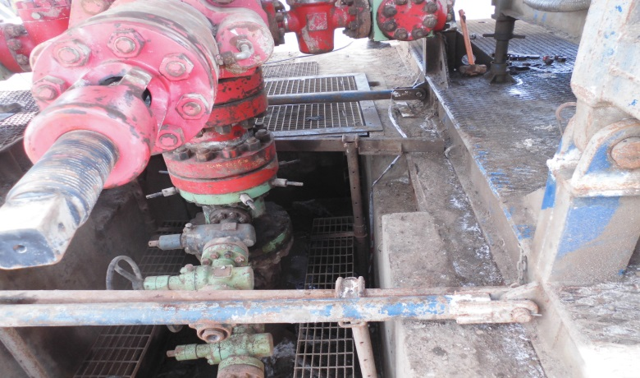
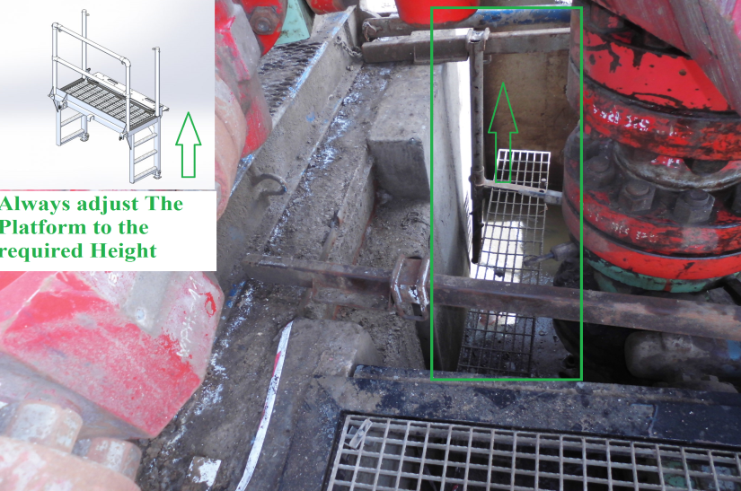
PDO Second Alert
Date: 31.08.2017 Incident title LTI
What happened?
At 07:10hrs, an Assistant Driller was attempting to disconnect hydraulic 1” BOP hose from the Double Ram BOP (upper pipe Rams). While performing the task he lost balance falling into the cellar area striking the edge of the opening.
Your learning from this incident..
Always ensure a TRIC is conducted highlighting task specific hazards
Always use a working platform while working around an open cellar
Ensure cellars have adequate protection to prevent falls
Ensure a working platform is adjusted and used

Slide 2
Management self audit
Date: 31.08.2017 Incident title LTI
As a learning from this incident and to ensure continual improvement all contract managers must review their HSE HEMP against the questions asked below:
Confirm the following:
Do you enforce using working platforms while working in the cellar area?
Do your HSE audits/Inspections system capture shortcuts/shortfalls related to behaviors?
Do you perform a thorough risk assessment on slip, trip and fall hazards around the cellar area?
Do you ensure all controls identified in the HEMP are communicated to employees and transferred into TBT’s?
Notes:
Make a list of closed questions (only ‘yes’ or ‘no’ as an answer) to ask other contractors if they have the same issues based on the management or HSE-MS failings or shortfalls identified in the investigation. Pretend you have to audit other companies to see if they could have the same issues.

